Slide 1

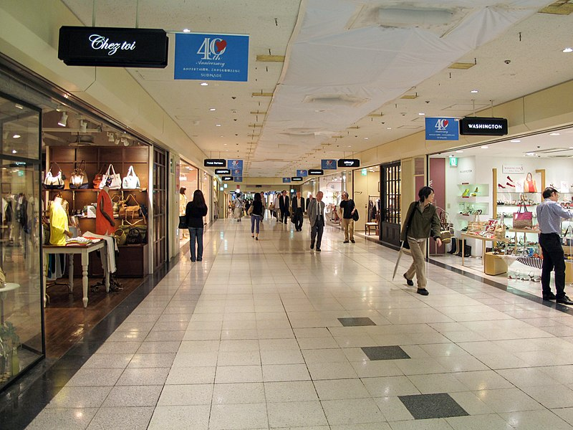
Motivating Puzzle
Suppose we have two shopping centers.
Suppose we pick a center randomly with probability 50%, and then pick a restaurant at that center with equal probability.
If we eat at a Moroccan restaurant, what is the chance we picked center 1?
Shopping center 1:
3 Indian restaurants
2 Moroccan restaurants
Shopping center 2:
1 Indian restaurant
1 Moroccan restaurant

Slide 2
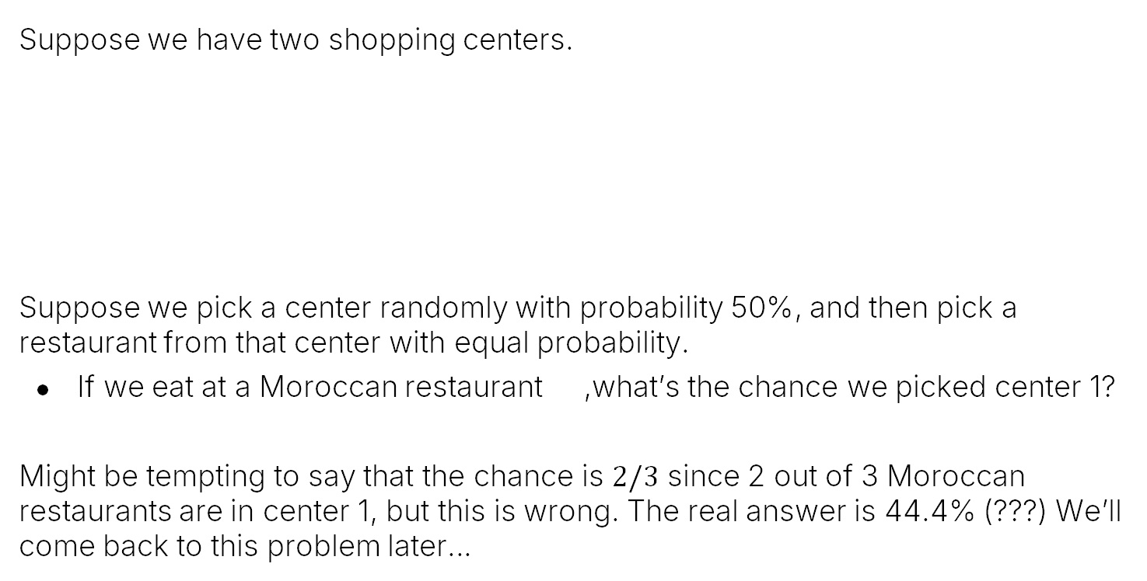
Motivating Puzzle
Suppose we have two shopping centers.
Suppose we pick a center randomly with probability 50%, and then pick a restaurant from that center with equal probability.
If we eat at a Moroccan restaurant ,what’s the chance we picked center 1?
Might be tempting to say that the chance is $2/3$ since 2 out of 3 Moroccan restaurants are in center 1, but this is wrong. The real answer is 44.4% (???) We’ll come back to this problem later…
Shopping center 1:
3 Indian restaurants
2 Moroccan restaurants
Shopping center 2:
1 Indian restaurant
1 Moroccan restaurant

Slide 3
Conditional Probability of an Outcome
Conditional Probabilities:
Conditional Probability of an Outcome
Conditional Probability of an Event
Bayesian Inference
Bayes Rule and the Total Probability Rule (TPR)
Applications of Bayes and TPR
Generalized Bayes and TPR
Combinations of Events
Independence
Intersections and The Product Rule
Product Rule Applications and Proof and Proof
Unions of Events
Unions of Events (Large N)
Summary
Notes 14
Lecture 16/17, CS70 Fall 2025

Slide 4
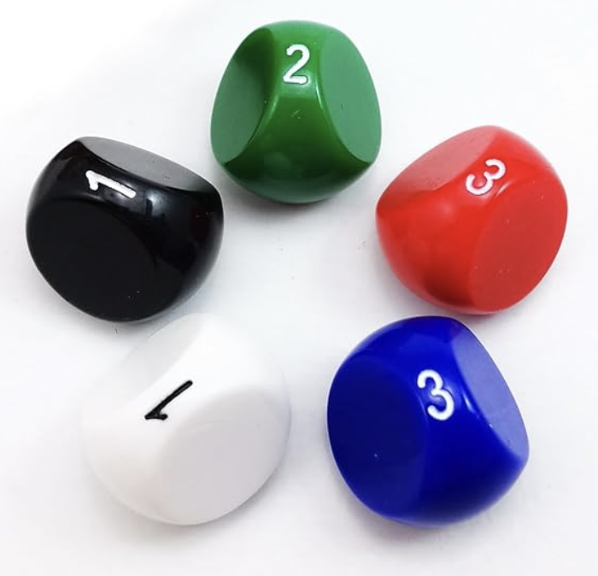
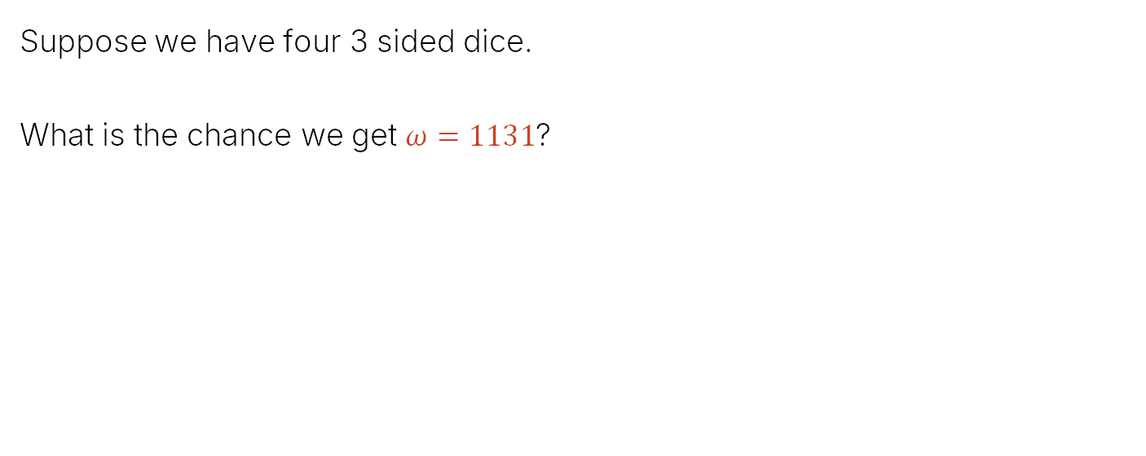
Dice Rolling Review 1: Chance of a Specific Outcome
Suppose we have four 3 sided dice.
What is the chance we get $ω=1131$?
Note: Notes 14, section 1 give this example as a balls and bins problem, but I think it’s easier to follow as dice.
https://www.amazon.com/Bescon-Polyhedral-3-sided-Gaming-Assorted/dp/B06XHF4Y6J?th=1

Slide 5
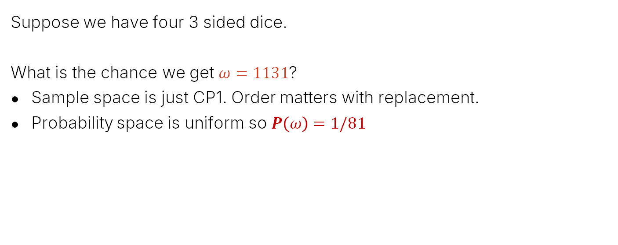


Dice Rolling Review 1: Chance of a Specific Outcome
Suppose we have four 3 sided dice.
What is the chance we get $ω=1131$?
Sample space is just CP1. Order matters with replacement.
Probability space is uniform so $P\left(ω\right)=1/81$
$$\left|Ω\right|=81$$
$$ω:1131$$
$$P\left(ω\right)=1/81$$

Slide 6
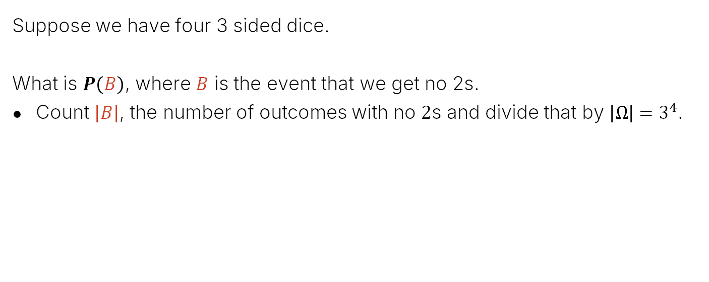
Dice Rolling Review 2: Chance of an Event
Suppose we have four 3 sided dice.
What is $P\left(B\right)$, where $B$ is the event that we get no 2s.
Count $\left|B\right|$, the number of outcomes with no $2$s and divide that by ${\left|Ω\right|=3}^{4}$.
$$\left|Ω\right|=81$$
$$ω:1131$$
$$P\left(ω\right)=1/81$$

Slide 7
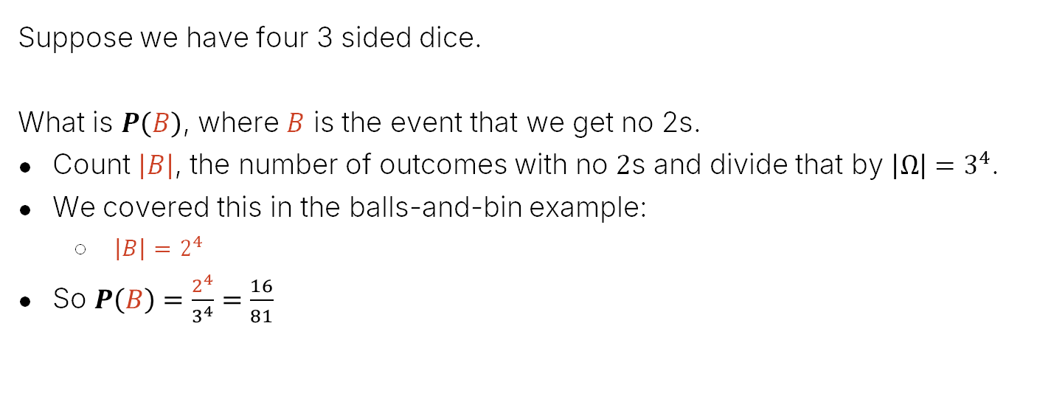

Dice Rolling Review 2: Chance of an Event
Suppose we have four 3 sided dice.
What is $P\left(B\right)$, where $B$ is the event that we get no 2s.
Count $\left|B\right|$, the number of outcomes with no $2$s and divide that by ${\left|Ω\right|=3}^{4}$.
We covered this in the balls-and-bin example:
$\left|B\right|=2^{4}$
So $P\left(B\right)=\frac{2^{4}}{3^{4}}=\frac{16}{81}$
$$\left|Ω\right|=81$$
$$B$$
$$ω:1131$$
$$P\left(ω\right)=1/81$$

Slide 8


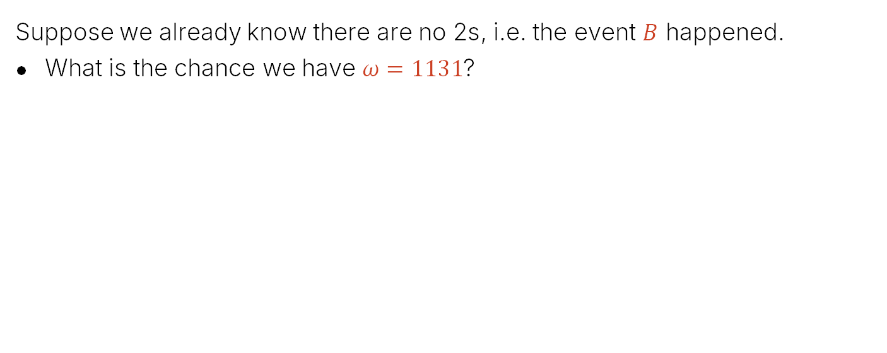
New Idea: Conditional Probability
Suppose we already know there are no 2s, i.e. the event $B$ happened.
What is the chance we have $ω=1131$?
https://joshh.ug/A
$$\left|Ω\right|=81$$
$$B$$
$$\left|B\right|=16$$

Slide 9
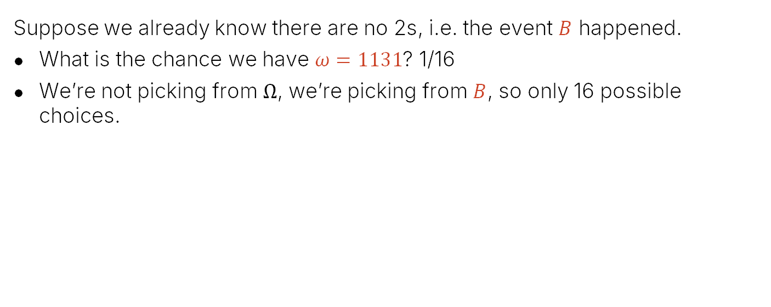
New Idea: Conditional Probability
Suppose we already know there are no 2s, i.e. the event $B$ happened.
What is the chance we have $ω=1131$? 1/16
We’re not picking from $Ω$, we’re picking from $B$, so only 16 possible choices.
$$\left|Ω\right|=81$$
$$B$$
$$\left|B\right|=16$$

Slide 10
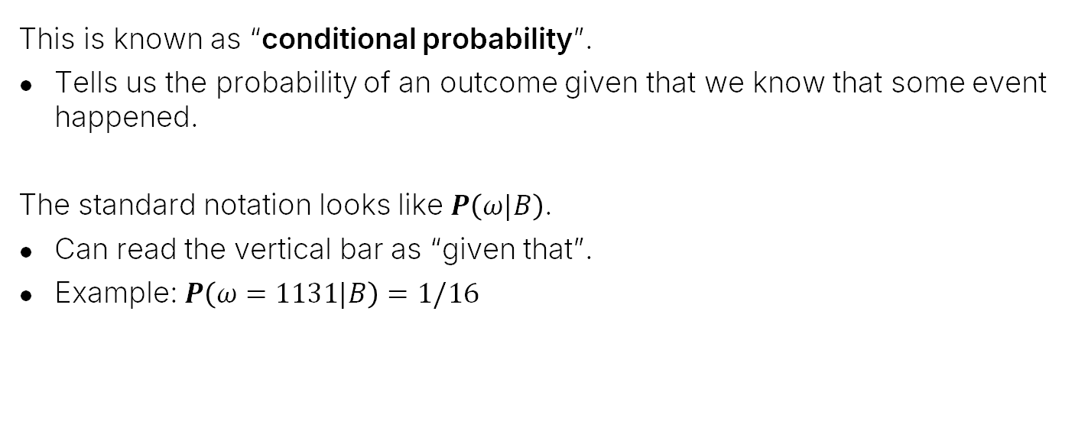

New Idea: Conditional Probability
This is known as “conditional probability”.
Tells us the probability of an outcome given that we know that some event happened.
The standard notation looks like $P\left(ω|B\right)$.
Can read the vertical bar as “given that”.
Example: $P\left(ω=1131|B\right)=1/16$
$$\left|Ω\right|=81$$
$$B$$
$$ω:1131$$
$$P\left(ω|B\right)=\left|B\right|=1/16$$

Slide 11
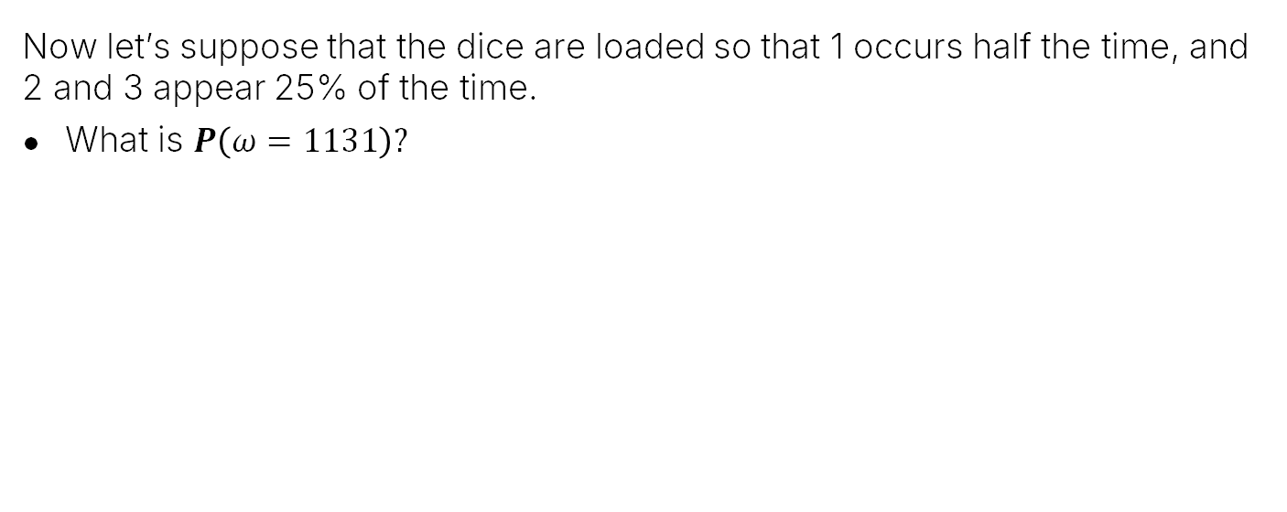

New Idea: Conditional Probability
Now let’s suppose that the dice are loaded so that 1 occurs half the time, and 2 and 3 appear 25% of the time.
What is $P\left(ω=1131\right)?$
$$\left|Ω\right|=81$$
$$P\left(ω=1131\right)= ??$$

Slide 12
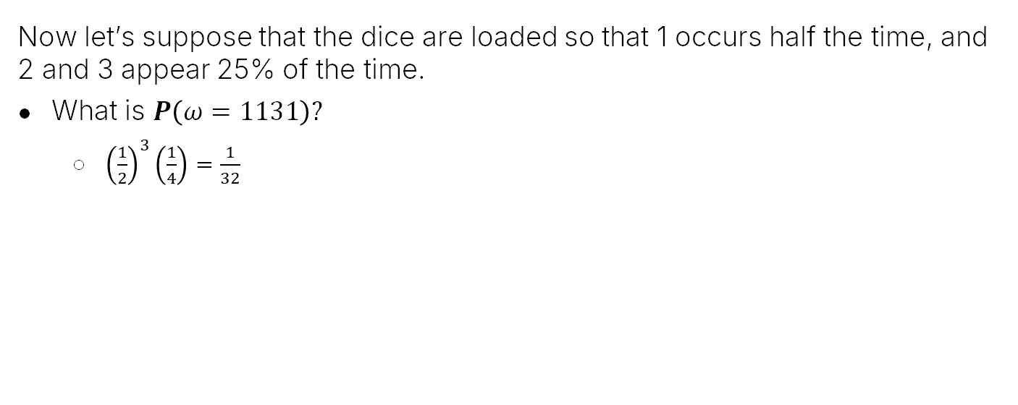

New Idea: Conditional Probability
Now let’s suppose that the dice are loaded so that 1 occurs half the time, and 2 and 3 appear 25% of the time.
What is $P\left(ω=1131\right)?$
${\left(\frac{1}{2}\right)}^{3}\left(\frac{1}{4}\right)=\frac{1}{32}$
$$\left|Ω\right|=81$$
$$P\left(ω=1131\right)=\frac{1}{32}$$

Slide 13
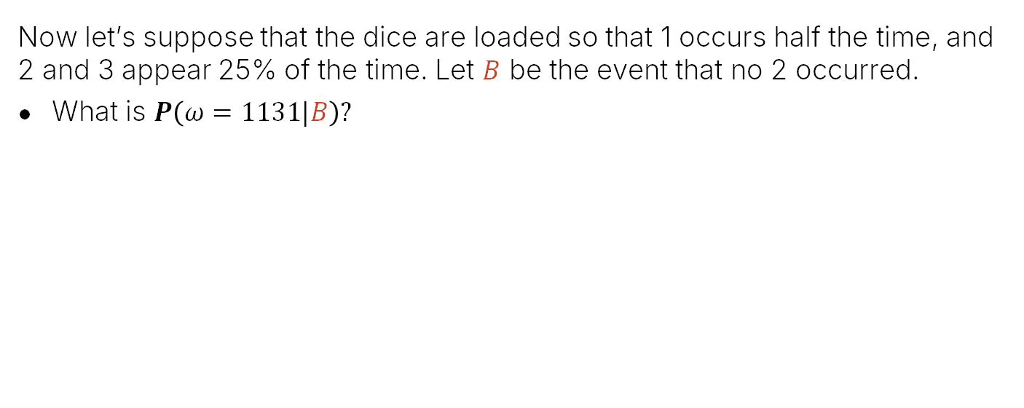

New Idea: Conditional Probability
Now let’s suppose that the dice are loaded so that 1 occurs half the time, and 2 and 3 appear 25% of the time. Let $B$ be the event that no 2 occurred.
What is $P\left(ω=1131|B\right)?$
$$\left|Ω\right|=81$$
$$B$$
$$P\left(ω=1131|B\right)= ??$$

Slide 14
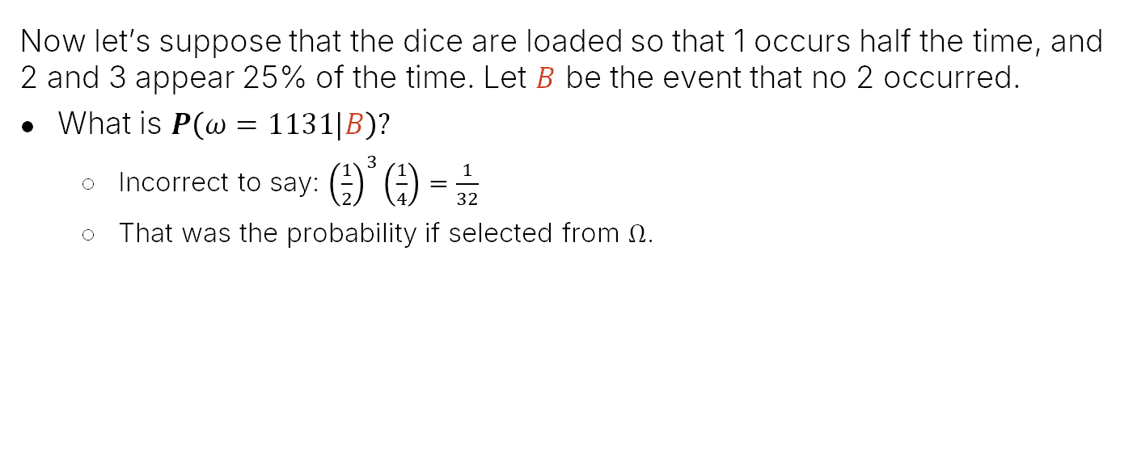

New Idea: Conditional Probability
Now let’s suppose that the dice are loaded so that 1 occurs half the time, and 2 and 3 appear 25% of the time. Let $B$ be the event that no 2 occurred.
What is $P\left(ω=1131|B\right)?$
Incorrect to say: ${\left(\frac{1}{2}\right)}^{3}\left(\frac{1}{4}\right)=\frac{1}{32}$
That was the probability if selected from $Ω$.
$$\left|Ω\right|=81$$
$$B$$
$$P\left(ω=1131|B\right)= ??≠\frac{1}{32}$$

Slide 15
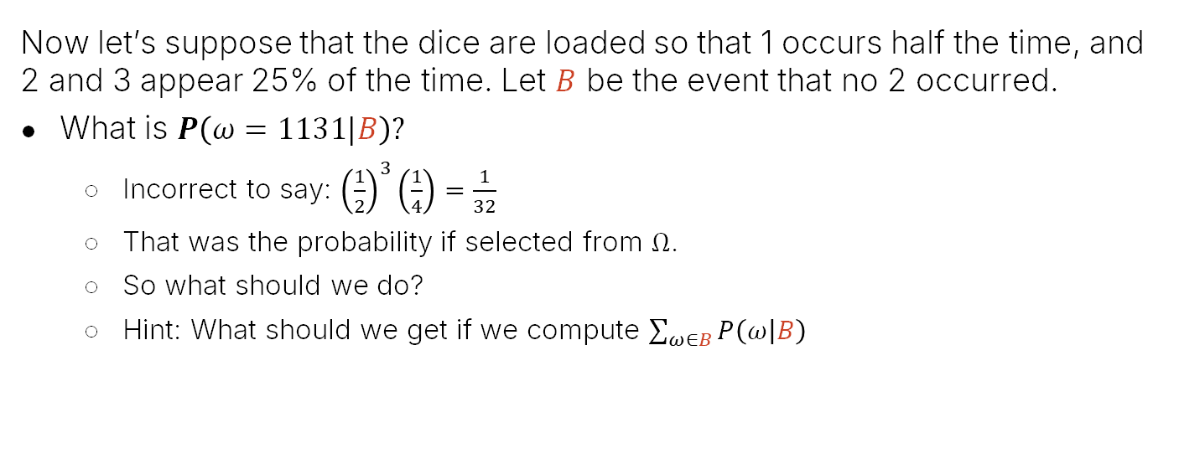

New Idea: Conditional Probability
Now let’s suppose that the dice are loaded so that 1 occurs half the time, and 2 and 3 appear 25% of the time. Let $B$ be the event that no 2 occurred.
What is $P\left(ω=1131|B\right)?$
Incorrect to say: ${\left(\frac{1}{2}\right)}^{3}\left(\frac{1}{4}\right)=\frac{1}{32}$
That was the probability if selected from $Ω$.
So what should we do?
Hint: What should we get if we compute $\sum_{ω∈B}{P\left(ω | B\right)}$
$$\left|Ω\right|=81$$
$$B$$
$$P\left(ω=1131|B\right)= ??≠\frac{1}{32}$$

Slide 16
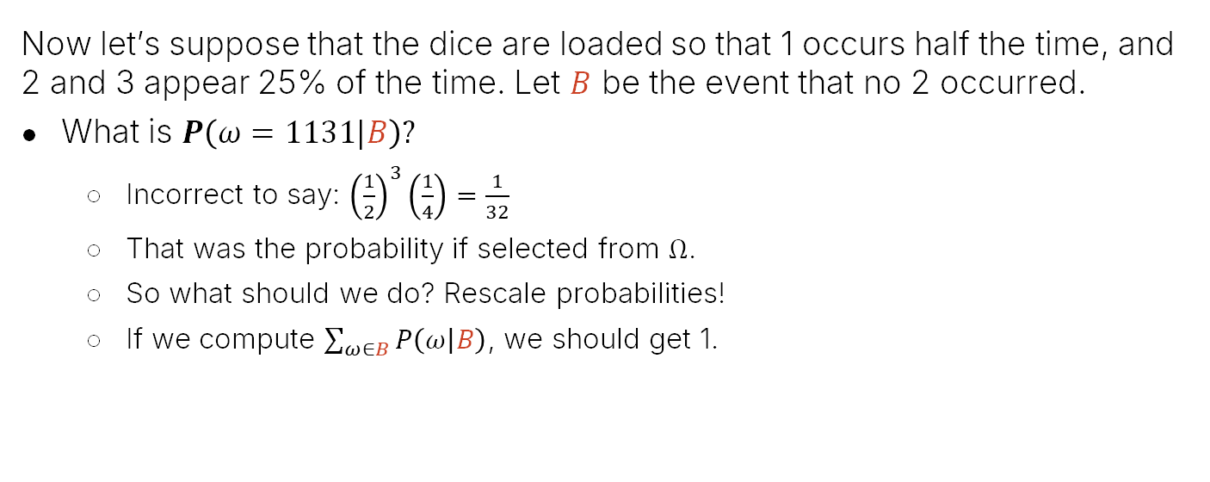
New Idea: Conditional Probability
Now let’s suppose that the dice are loaded so that 1 occurs half the time, and 2 and 3 appear 25% of the time. Let $B$ be the event that no 2 occurred.
What is $P\left(ω=1131|B\right)?$
Incorrect to say: ${\left(\frac{1}{2}\right)}^{3}\left(\frac{1}{4}\right)=\frac{1}{32}$
That was the probability if selected from $Ω$.
So what should we do? Rescale probabilities!
If we compute $\sum_{ω∈B}{P\left(ω | B\right)}$, we should get 1.
$$\left|Ω\right|=81$$
$$B$$
$$P\left(ω=1131|B\right)= ??≠\frac{1}{32}$$

Slide 17
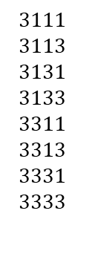

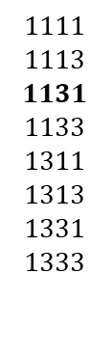
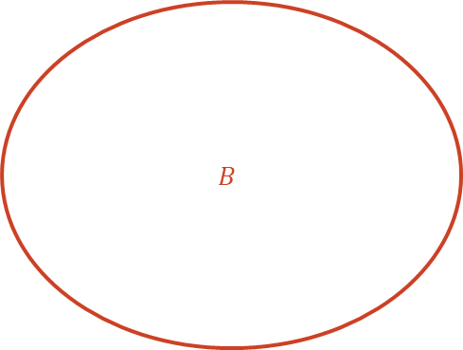
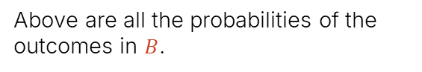

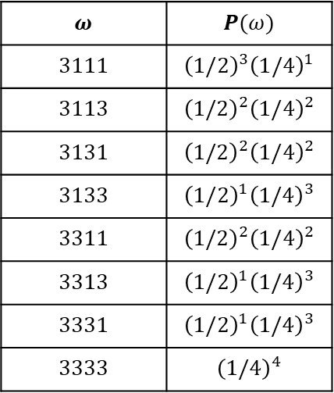

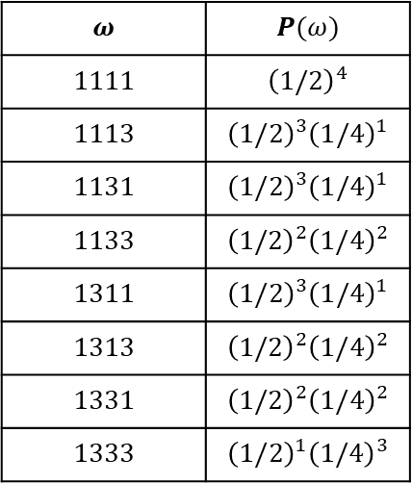
All of the Outcomes in $B$
$$ω$$ | $$P(ω)$$
$$1111$$ | $${\left(1/2\right)}^{4}$$
$$1113$$ | $${\left(1/2\right)}^{3}{\left(1/4\right)}^{1}$$
$$1131$$ | $${\left(1/2\right)}^{3}{\left(1/4\right)}^{1}$$
$$1133$$ | $${\left(1/2\right)}^{2}{\left(1/4\right)}^{2}$$
$$1311$$ | $${\left(1/2\right)}^{3}{\left(1/4\right)}^{1}$$
$$1313$$ | $${\left(1/2\right)}^{2}{\left(1/4\right)}^{2}$$
$$1331$$ | $${\left(1/2\right)}^{2}{\left(1/4\right)}^{2}$$
$$1333$$ | $${\left(1/2\right)}^{1}{\left(1/4\right)}^{3}$$
$$ω$$ | $$P(ω)$$
$$3111$$ | $${\left(1/2\right)}^{3}{\left(1/4\right)}^{1}$$
$$3113$$ | $${\left(1/2\right)}^{2}{\left(1/4\right)}^{2}$$
$$3131$$ | $${\left(1/2\right)}^{2}{\left(1/4\right)}^{2}$$
$$3133$$ | $${\left(1/2\right)}^{1}{\left(1/4\right)}^{3}$$
$$3311$$ | $${\left(1/2\right)}^{2}{\left(1/4\right)}^{2}$$
$$3313$$ | $${\left(1/2\right)}^{1}{\left(1/4\right)}^{3}$$
$$3331$$ | $${\left(1/2\right)}^{1}{\left(1/4\right)}^{3}$$
$$3333$$ | $${\left(1/4\right)}^{4}$$
$$B$$
$$1111$$
$$1113$$
$$1131$$
$$1133$$
$$1311$$
$$1313$$
$$1331$$
$$1333$$
$$3111$$
$$3113$$
$$3131$$
$$3133$$
$$3311$$
$$3313$$
$$3331$$
$$3333$$
$$\left|Ω\right|=81$$
Above are all the probabilities of the outcomes in $B$.
$$Ω=$$
$$B$$
Note to future Josh Hug: Use a simpler example next time. For example six weighted strings, three of which start with c.

Slide 18
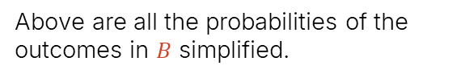
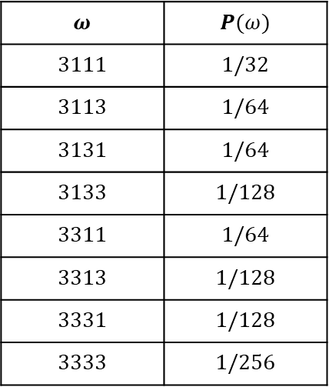
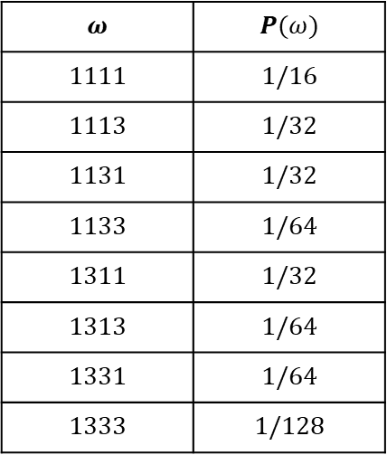
Probability of All of the Outcomes in $B$
$$ω$$ | $$P(ω)$$
$$1111$$ | $$1/16$$
$$1113$$ | $$1/32$$
$$1131$$ | $$1/32$$
$$1133$$ | $$1/64$$
$$1311$$ | $$1/32$$
$$1313$$ | $$1/64$$
$$1331$$ | $$1/64$$
$$1333$$ | $$1/128$$
$$ω$$ | $$P(ω)$$
$$3111$$ | $$1/32$$
$$3113$$ | $$1/64$$
$$3131$$ | $$1/64$$
$$3133$$ | $$1/128$$
$$3311$$ | $$1/64$$
$$3313$$ | $$1/128$$
$$3331$$ | $$1/128$$
$$3333$$ | $$1/256$$
$$B$$
$$1111$$
$$1113$$
$$1131$$
$$1133$$
$$1311$$
$$1313$$
$$1331$$
$$1333$$
$$3111$$
$$3113$$
$$3131$$
$$3133$$
$$3311$$
$$3313$$
$$3331$$
$$3333$$
$$\left|Ω\right|=81$$
Above are all the probabilities of the outcomes in $B$ simplified.
$$Ω=$$
$$B$$

Slide 19
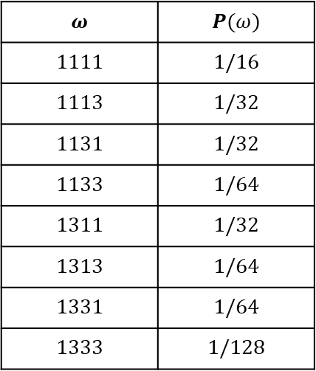
Probability of All of the Outcomes in $B$
$$ω$$ | $$P(ω)$$
$$1111$$ | $$1/16$$
$$1113$$ | $$1/32$$
$$1131$$ | $$1/32$$
$$1133$$ | $$1/64$$
$$1311$$ | $$1/32$$
$$1313$$ | $$1/64$$
$$1331$$ | $$1/64$$
$$1333$$ | $$1/128$$
$$ω$$ | $$P(ω)$$
$$3111$$ | $$1/32$$
$$3113$$ | $$1/64$$
$$3131$$ | $$1/64$$
$$3133$$ | $$1/128$$
$$3311$$ | $$1/64$$
$$3313$$ | $$1/128$$
$$3331$$ | $$1/128$$
$$3333$$ | $$1/256$$
$$B$$
$$1111$$
$$1113$$
$$1131$$
$$1133$$
$$1311$$
$$1313$$
$$1331$$
$$1333$$
$$3111$$
$$3113$$
$$3131$$
$$3133$$
$$3311$$
$$3313$$
$$3331$$
$$3333$$
$$\left|Ω\right|=81$$
How do we rescale these probabilities so that they sum to 1?
$$Ω=$$
$$B$$

Slide 20
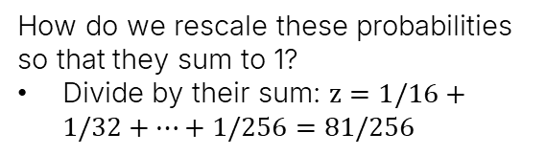
Probability of All of the Outcomes in $B$
$$ω$$ | $$P(ω)$$
$$1111$$ | $$1/16$$
$$1113$$ | $$1/32$$
$$1131$$ | $$1/32$$
$$1133$$ | $$1/64$$
$$1311$$ | $$1/32$$
$$1313$$ | $$1/64$$
$$1331$$ | $$1/64$$
$$1333$$ | $$1/128$$
$$ω$$ | $$P(ω)$$
$$3111$$ | $$1/32$$
$$3113$$ | $$1/64$$
$$3131$$ | $$1/64$$
$$3133$$ | $$1/128$$
$$3311$$ | $$1/64$$
$$3313$$ | $$1/128$$
$$3331$$ | $$1/128$$
$$3333$$ | $$1/256$$
$$B$$
$$1111$$
$$1113$$
$$1131$$
$$1133$$
$$1311$$
$$1313$$
$$1331$$
$$1333$$
$$3111$$
$$3113$$
$$3131$$
$$3133$$
$$3311$$
$$3313$$
$$3331$$
$$3333$$
$$\left|Ω\right|=81$$
How do we rescale these probabilities so that they sum to 1?
Divide by their sum: $z=1/16+1/32+…+1/256=81/256$
$$Ω=$$
$$B$$

Slide 21
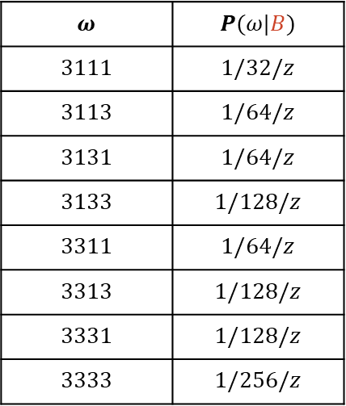
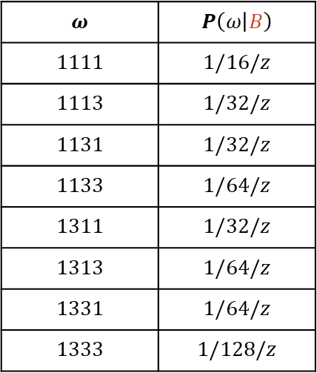
Conditional Probability of all of the Outcomes in $B$
$$ω$$ | $$P\left(ω | B\right)$$
$$1111$$ | $$1/16/z$$
$$1113$$ | $$1/32/z$$
$$1131$$ | $$1/32/z$$
$$1133$$ | $$1/64/z$$
$$1311$$ | $$1/32/z$$
$$1313$$ | $$1/64/z$$
$$1331$$ | $$1/64/z$$
$$1333$$ | $$1/128/z$$
$$ω$$ | $$P(ω|B)$$
$$3111$$ | $$1/32/z$$
$$3113$$ | $$1/64/z$$
$$3131$$ | $$1/64/z$$
$$3133$$ | $$1/128/z$$
$$3311$$ | $$1/64/z$$
$$3313$$ | $$1/128/z$$
$$3331$$ | $$1/128/z$$
$$3333$$ | $$1/256/z$$
$$B$$
$$1111$$
$$1113$$
$$1131$$
$$1133$$
$$1311$$
$$1313$$
$$1331$$
$$1333$$
$$3111$$
$$3113$$
$$3131$$
$$3133$$
$$3311$$
$$3313$$
$$3331$$
$$3333$$
$$\left|Ω\right|=81$$
How do we rescale these probabilities so that they sum to 1?
Divide by their sum: $z=1/16+1/32+…+1/256=81/256$
$$Ω=$$
$$B$$

Slide 22

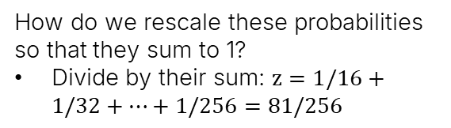
Conditional Probability of all of the Outcomes in $B$
$$ω$$ | $$P\left(ω | B\right)$$
$$1111$$ | $$1/16/z$$
$$1113$$ | $$1/32/z$$
$$1131$$ | $$1/32/z$$
$$1133$$ | $$1/64/z$$
$$1311$$ | $$1/32/z$$
$$1313$$ | $$1/64/z$$
$$1331$$ | $$1/64/z$$
$$1333$$ | $$1/128/z$$
$$ω$$ | $$P(ω|B)$$
$$3111$$ | $$1/32/z$$
$$3113$$ | $$1/64/z$$
$$3131$$ | $$1/64/z$$
$$3133$$ | $$1/128/z$$
$$3311$$ | $$1/64/z$$
$$3313$$ | $$1/128/z$$
$$3331$$ | $$1/128/z$$
$$3333$$ | $$1/256/z$$
$$B$$
$$1111$$
$$1113$$
$$1131$$
$$1133$$
$$1311$$
$$1313$$
$$1331$$
$$1333$$
$$3111$$
$$3113$$
$$3131$$
$$3133$$
$$3311$$
$$3313$$
$$3331$$
$$3333$$
How do we rescale these probabilities so that they sum to 1?
Divide by their sum: $z=1/16+1/32+…+1/256=81/256$
$$\left|Ω\right|=81$$
$$Ω=$$
$$B$$
Question: What is $z$?

Slide 23
Conditional Probability of all of the Outcomes in $B$
$$ω$$ | $$P\left(ω | B\right)$$
$$1111$$ | $$1/16/z$$
$$1113$$ | $$1/32/z$$
$$1131$$ | $$1/32/z$$
$$1133$$ | $$1/64/z$$
$$1311$$ | $$1/32/z$$
$$1313$$ | $$1/64/z$$
$$1331$$ | $$1/64/z$$
$$1333$$ | $$1/128/z$$
$$ω$$ | $$P(ω|B)$$
$$3111$$ | $$1/32/z$$
$$3113$$ | $$1/64/z$$
$$3131$$ | $$1/64/z$$
$$3133$$ | $$1/128/z$$
$$3311$$ | $$1/64/z$$
$$3313$$ | $$1/128/z$$
$$3331$$ | $$1/128/z$$
$$3333$$ | $$1/256/z$$
$$B$$
$$1111$$
$$1113$$
$$1131$$
$$1133$$
$$1311$$
$$1313$$
$$1331$$
$$1333$$
$$3111$$
$$3113$$
$$3131$$
$$3133$$
$$3311$$
$$3313$$
$$3331$$
$$3333$$
How do we rescale these probabilities so that they sum to 1?
Divide by their sum: $z=1/16+1/32+…+1/256=81/256$
$$\left|Ω\right|=81$$
$$Ω=$$
$$B$$
Question: What is $z$? It’s just $P\left(B\right)$!

Slide 24
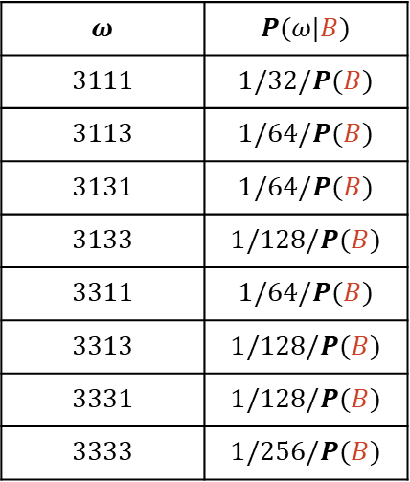
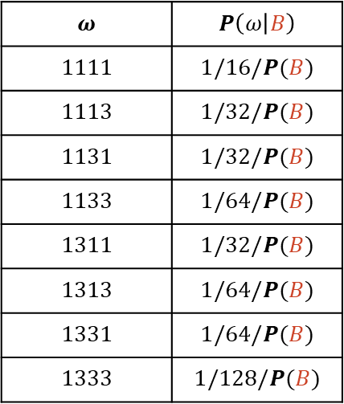
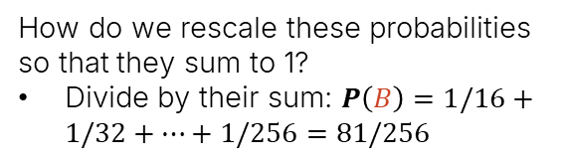
Conditional Probability of all of the Outcomes in $B$
$$ω$$ | $$P\left(ω | B\right)$$
$$1111$$ | $$1/16/P(B)$$
$$1113$$ | $$1/32/P(B)$$
$$1131$$ | $$1/32/P(B)$$
$$1133$$ | $$1/64/P(B)$$
$$1311$$ | $$1/32/P(B)$$
$$1313$$ | $$1/64/P(B)$$
$$1331$$ | $$1/64/P(B)$$
$$1333$$ | $$1/128/P(B)$$
$$ω$$ | $$P(ω|B)$$
$$3111$$ | $$1/32/P(B)$$
$$3113$$ | $$1/64/P(B)$$
$$3131$$ | $$1/64/P(B)$$
$$3133$$ | $$1/128/P(B)$$
$$3311$$ | $$1/64/P(B)$$
$$3313$$ | $$1/128/P(B)$$
$$3331$$ | $$1/128/P(B)$$
$$3333$$ | $$1/256/P(B)$$
$$B$$
$$1111$$
$$1113$$
$$1131$$
$$1133$$
$$1311$$
$$1313$$
$$1331$$
$$1333$$
$$3111$$
$$3113$$
$$3131$$
$$3133$$
$$3311$$
$$3313$$
$$3331$$
$$3333$$
How do we rescale these probabilities so that they sum to 1?
Divide by their sum: $P\left(B\right)=1/16+1/32+…+1/256=81/256$
$$\left|Ω\right|=81$$
$$Ω=$$
$$B$$
Question: What is $z$? It’s just $P\left(B\right)$!

Slide 25
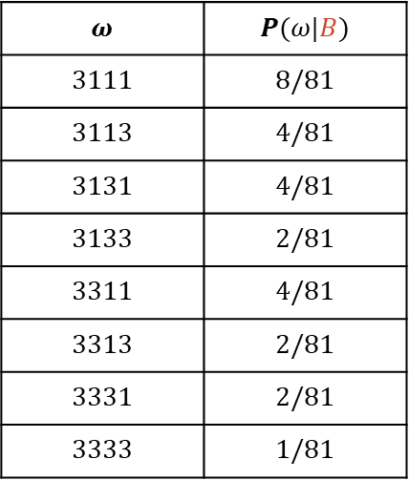
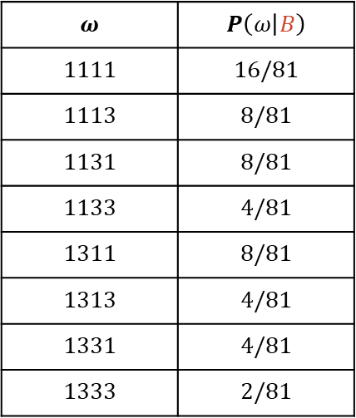
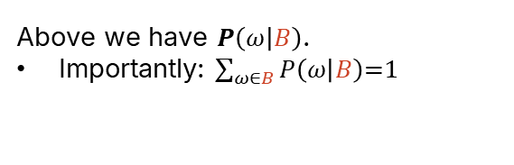
Conditional Probability of all of the Outcomes in $B$
$$ω$$ | $$P\left(ω | B\right)$$
$$1111$$ | $$16/81$$
$$1113$$ | $$8/81$$
$$1131$$ | $$8/81$$
$$1133$$ | $$4/81$$
$$1311$$ | $$8/81$$
$$1313$$ | $$4/81$$
$$1331$$ | $$4/81$$
$$1333$$ | $$2/81$$
$$ω$$ | $$P(ω|B)$$
$$3111$$ | $$8/81$$
$$3113$$ | $$4/81$$
$$3131$$ | $$4/81$$
$$3133$$ | $$2/81$$
$$3311$$ | $$4/81$$
$$3313$$ | $$2/81$$
$$3331$$ | $$2/81$$
$$3333$$ | $$1/81$$
$$B$$
$$1111$$
$$1113$$
$$1131$$
$$1133$$
$$1311$$
$$1313$$
$$1331$$
$$1333$$
$$3111$$
$$3113$$
$$3131$$
$$3133$$
$$3311$$
$$3313$$
$$3331$$
$$3333$$
$$\left|Ω\right|=81$$
Above we have $P\left(ω | B\right)$.
Importantly: $\sum_{ω∈B}{P\left(ω | B\right)\text{=1}}$
$$Ω=$$
$$B$$

Slide 26
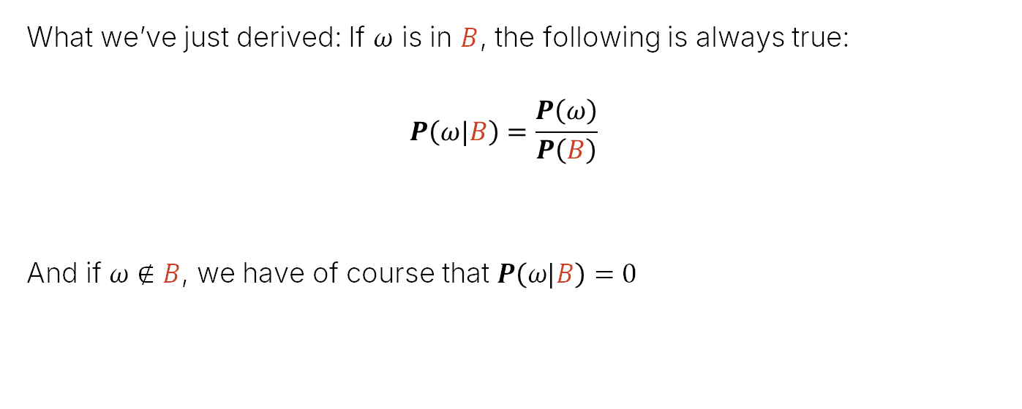
The Conditional Probability Formula
What we’ve just derived: If $ω$ is in $B$, the following is always true:
$$P\left(ω|B\right)=\frac{P\left(ω\right)}{P\left(B\right)}$$
And if $ω∉B$, we have of course that $P\left(ω|B\right)=0$

Slide 27
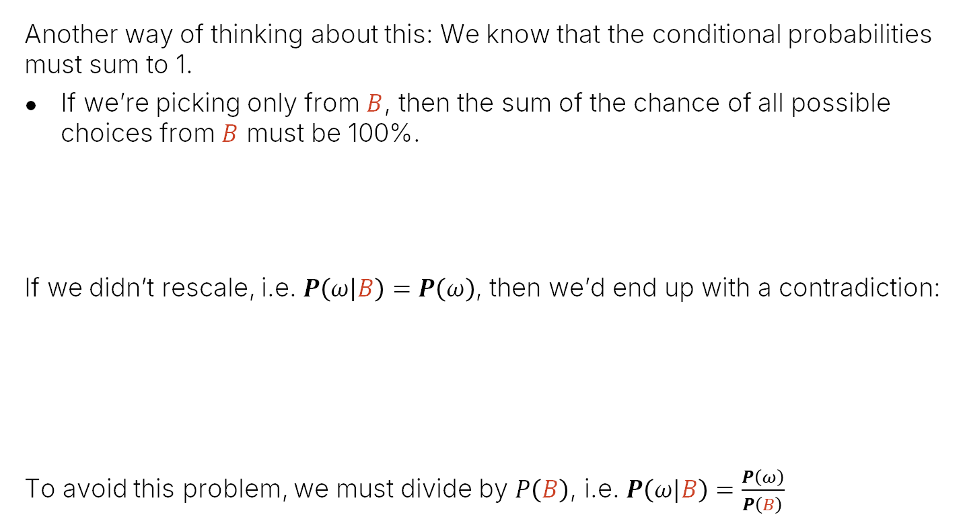
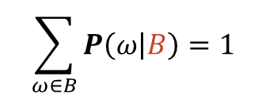
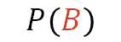
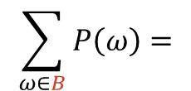
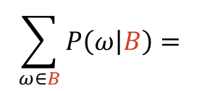
Another Viewpoint
Another way of thinking about this: We know that the conditional probabilities must sum to 1.
If we’re picking only from $B$, then the sum of the chance of all possible choices from $B$ must be 100%.
If we didn’t rescale, i.e. $P\left(ω | B\right)=P\left(ω\right)$, then we’d end up with a contradiction:
To avoid this problem, we must divide by $P\left(B\right)$, i.e. $P\left(ω|B\right)=\frac{P\left(ω\right)}{P\left(B\right)}$
$$\sum_{ω∈B}{P\left(ω | B\right)}=1$$
$$\sum_{ω∈B}{P\left(ω | B\right)}=$$
$$\sum_{ω∈B}{P\left(ω\right)}=$$
$$P\left(B\right)$$

Slide 28
Conditional Probability of an Event
Conditional Probabilities:
Conditional Probability of an Outcome
Conditional Probability of an Event
Bayesian Inference
Bayes Rule and the Total Probability Rule (TPR)
Applications of Bayes and TPR
Generalized Bayes and TPR
Combinations of Events
Independence
Intersections and The Product Rule
Product Rule Applications and Proof
Unions of Events
Unions of Events (Large N)
Summary
Notes 14
Lecture 16/17, CS70 Fall 2025

Slide 29

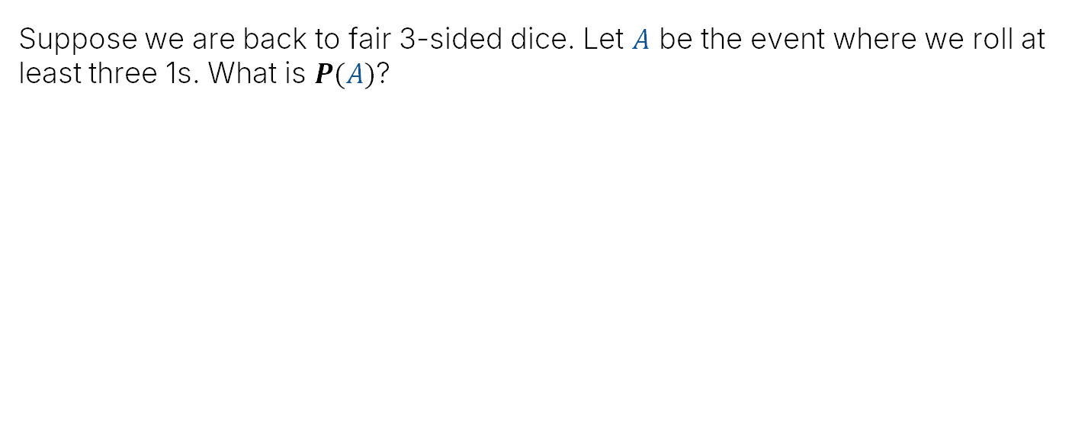
Another Dice Rolling Problem
Suppose we are back to fair 3-sided dice. Let $A$ be the event where we roll at least three 1s. What is $P(A)$?
$$β$$

Slide 30


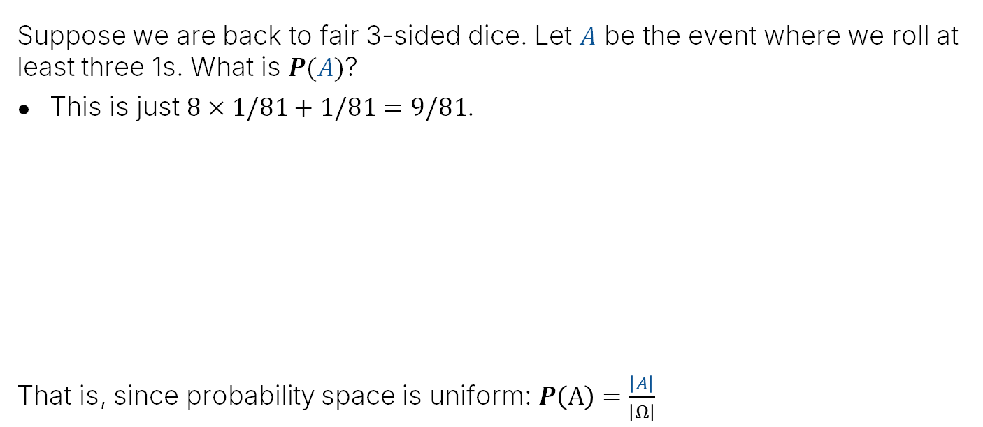
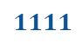
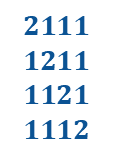
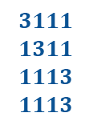
Another Dice Rolling Problem
Suppose we are back to fair 3-sided dice. Let $A$ be the event where we roll at least three 1s. What is $P(A)$?
This is just $8×1/81+1/81=9/81$.
That is, since probability space is uniform: $P\left(A\right)=\frac{\left|A\right|}{\left|Ω\right|}$
$$β$$
Chance of three 1s
Chance of four 1s.
$$2111$$
$$1211$$
$$1121$$
$$1112$$
$$3111$$
$$1311$$
$$1113$$
$$1113$$
$$1111$$
A
$$\left|A\right|=9$$
$$Ω=$$

Slide 31
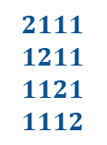
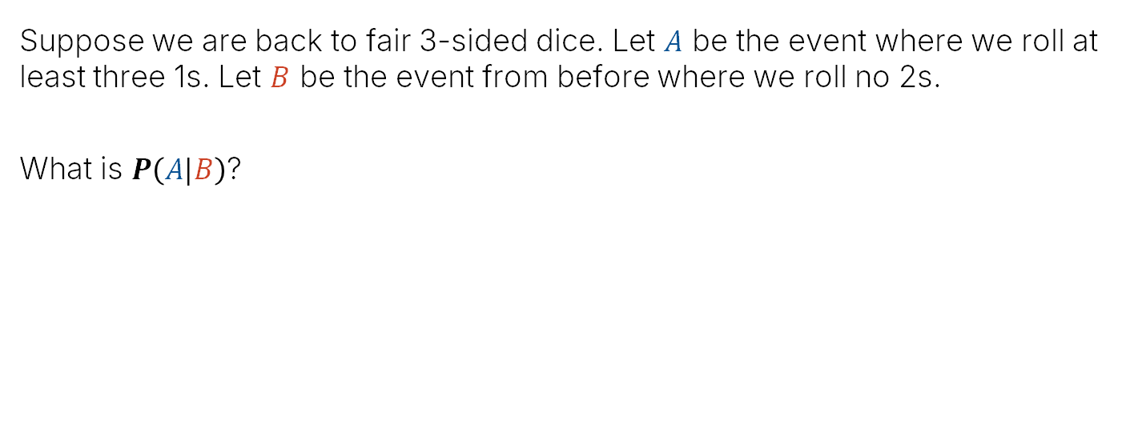
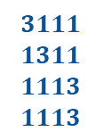

Conditional Probability of an Event
Suppose we are back to fair 3-sided dice. Let $A$ be the event where we roll at least three 1s. Let $B$ be the event from before where we roll no 2s.
What is $P\left(A|B\right)$?
$$2111$$
$$1211$$
$$1121$$
$$1112$$
$$3111$$
$$1311$$
$$1113$$
$$1113$$
$$1111$$
A
$$\left|A\right|=9$$
$$Ω=$$
B
$$\left|B\right|=16$$

Slide 32

Conditional Probability of an Event
Suppose we are back to fair 3-sided dice. Let $A$ be the event where we roll at least three 1s. Let $B$ be the event from before where we roll no 2s.
What is $P\left(A|B\right)$?
We know that the probability of an event is just the sum of probabilities of individual outcomes.
$$P\left(A|B\right) \text{=}\sum_{ω∈A}{P\left(ω | B\right)}$$
So: $P\left(A|B\right)=P\left(ω=2111 | B\right)+…+P\left(ω=1111 | B\right)$
$$2111$$
$$1211$$
$$1121$$
$$1112$$
$$3111$$
$$1311$$
$$1113$$
$$1113$$
$$1111$$
A
$$Ω=$$
B

Slide 33

Conditional Probability of an Event
Suppose we are back to fair 3-sided dice. Let $A$ be the event where we roll at least three 1s. Let $B$ be the event from before where we roll no 2s.
What is $P\left(A|B\right)$?
We know that the probability of an event is just the sum of probabilities of individual outcomes.
$$P\left(A|B\right) \text{=}\sum_{ω∈A}{P\left(ω | B\right)}$$
So: $P\left(A|B\right)=P\left(ω=2111 | B\right)+…+P\left(ω=1111 | B\right)$
https://joshh.ug/B
$$2111$$
$$1211$$
$$1121$$
$$1112$$
$$3111$$
$$1311$$
$$1113$$
$$1113$$
$$1111$$
A
$$\left|A\right|=9$$
$$Ω=$$
B
What are these values?
$$\left|B\right|=16$$

Slide 34


Conditional Probability of an Event
Suppose we are back to fair 3-sided dice. Let $A$ be the event where we roll at least three 1s. Let $B$ be the event from before where we roll no 2s.
What is $P\left(A|B\right)$?
We know that the probability of an event is just the sum of probabilities of individual outcomes.
$$P\left(A|B\right) \text{=}\sum_{ω∈A}{P\left(ω | B\right)}$$
So: $P\left(A|B\right)=P\left(ω=2111 | B\right)+…+P\left(ω=1111 | B\right)$
$$2111$$
$$1211$$
$$1121$$
$$1112$$
$$3111$$
$$1311$$
$$1113$$
$$1113$$
$$1111$$
A
$$\left|A\right|=9$$
$$Ω=$$
B
$$0$$
$$1/16$$
$$\left|B\right|=16$$

Slide 35

Conditional Probability of an Event
Suppose we are back to fair 3-sided dice. Let $A$ be the event where we roll at least three 1s. Let $B$ be the event from before where we roll no 2s.
What is $P\left(A|B\right)$?
We know that the probability of an event is just the sum of probabilities of individual outcomes.
$$P\left(A|B\right) \text{=}\sum_{ω∈A}{P\left(ω | B\right)}$$
So: $P\left(A|B\right)= ??$
$$2111$$
$$1211$$
$$1121$$
$$1112$$
$$3111$$
$$1311$$
$$1113$$
$$1113$$
$$1111$$
A
$$\left|A\right|=9$$
$$Ω=$$
B
$$\left|B\right|=16$$

Slide 36



Conditional Probability of an Event
Suppose we are back to fair 3-sided dice. Let $A$ be the event where we roll at least three 1s. Let $B$ be the event from before where we roll no 2s.
What is $P\left(A|B\right)$?
We know that the probability of an event is just the sum of probabilities of individual outcomes.
$$P\left(A|B\right) \text{=}\sum_{ω∈A}{P\left(ω | B\right)}$$
So: $P\left(A|B\right)=5/16$
This is because 5 elements from $A$ are also in $B$.
$$2111$$
$$1211$$
$$1121$$
$$1112$$
$$3111$$
$$1311$$
$$1113$$
$$1113$$
$$1111$$
A
$$\left|A\right|=9$$
$$Ω=$$
B
$$\left|B\right|=16$$

Slide 37


Conditional Probability of an Event
We just saw that:
$$P\left(A|B\right) \text{=}\sum_{ω∈A}{P\left(ω | B\right)}$$
Which of the following is also correct? Select all that apply.
$P\left(A | B\right)=\sum_{ω∈B}{P\left(ω | B\right)}$
$P\left(A | B\right)=\sum_{ω∈A∪B}{P\left(ω | B\right)}$
$P\left(A | B\right)=\sum_{ω∈A∩B}{P\left(ω | B\right)}$
https://joshh.ug/C
A
$$\left|A\right|=9$$
$$Ω=$$
B
$$\left|B\right|=16$$

Slide 38

Conditional Probability of an Event
We just saw that:
$$P\left(A|B\right) \text{=}\sum_{ω∈A}{P\left(ω | B\right)}$$
Which of the following is also correct? Select all that apply.
$P\left(A | B\right)=\sum_{ω∈B}{P\left(ω | B\right)}$. No, this is just 1.
$P\left(A | B\right)=\sum_{ω∈A∪B}{P\left(ω | B\right)}$. No, this is also just 1.
$P\left(A | B\right)=\sum_{ω∈A∩B}{P\left(ω | B\right)}$. Yes! This is the equivalent of only summing over the purple items. Items only in $A$ have probability $P\left(ω∈\left(A∖B\right)|B\right)=0$
A
$$2111$$
$$1211$$
$$1121$$
$$1112$$
$$3111$$
$$1311$$
$$1113$$
$$1113$$
$$1111$$
$$\left|A\right|=9$$
$$Ω=$$
B
$$\left|B\right|=16$$

Slide 39


Conditional Probability of an Event
We just saw that:
$$P\left(A|B\right) \text{=}\sum_{ω∈A}{P\left(ω | B\right)}$$
Or we can write this as:
$$P\left(A|B\right) \text{=}\sum_{ω∈A∩B}{P\left(ω | B\right)}$$
Optional to add these since $P\left(ω∈A∖B|B\right)=0$
A
$$2111$$
$$1211$$
$$1121$$
$$1112$$
$$3111$$
$$1311$$
$$1113$$
$$1113$$
$$1111$$
$$\left|A\right|=9$$
$$Ω=$$
B
$$\left|B\right|=16$$

Slide 40






Conditional Probability of an Event
We’ve now derived that:
$$P\left(A|B\right) \text{=}\sum_{ω∈A∩B}{P\left(ω | B\right)}$$
We’re still not quite to the standard notation. To get there, let’s do a bit more algebra:
$$P\left(A|B\right) \text{=}\sum_{ω∈A∩B}{P\left(ω | B\right) }$$
$$\text{=}\sum_{ω∈A∩B}{\frac{P\left(ω\right)}{P(B)}}$$
$$=\frac{\sum_{ω∈A∩B}{P(ω)}}{P(B)}$$
$$=\frac{P(A∩B)}{P(B)}$$
A
$$\left|A\right|=9$$
$$Ω=$$
B
$$\left|A∩B\right|=5$$
$$\left|B\right|=16$$

Slide 41

Conditional Probability of an Event
This is the standard form for the conditional probability of an event.
$$P\left(A|B\right) \text{=}\frac{P(A∩B)}{P(B)}$$
Interpretation:
The numerator is the sum of the unconditional probabilities of the members of $A∩B$.
Then we rescale that sum by the probability of the event $P(B)$ (which is the sum of the unconditional probabilities of the members of $B$).
A
$$\left|A\right|=9$$
$$Ω=$$
B
$$\left|A∩B\right|=5$$
$$\left|B\right|=16$$

Slide 42

Definition 14.1 from the Notes
For events $A, B⊆Ω$ in the same probability space such that $P\left(B\right)>0$, the conditional probability of $A$ given $B$ is:
$$P\left(A|B\right) \text{=}\frac{P(A∩B)}{P(B)}$$
This expression is very common in the real world! Know it well.
But don’t lose sight of what it really means: You’re adding up all the probabilities of the purple items, each of which is scaled by dividing by the sums of the probabilities of the red items.

Slide 43


Example Using Conditional Probability Formula: Dealing Cards
Suppose we are dealt an ace in cards, and want to know the chance our next card will also be an ace. Here:
$B$: Event that first card was an ace.
$A$: Event that second card was an ace.
Let’s verify that $P\left(A | B\right)=\frac{P\left(A∩B\right)}{P\left(B\right)}$.
$P\left(B\right)=4/52$ since 4 out of 52 cards is an ace.
$P\left(A∩B\right)=\frac{12}{52×51}$ since there are $52×51$ ways of drawing two cards, and $4×3=12$ ways of getting two aces.
Thus chance that next card will be an ace is $\frac{12}{52×51}/\frac{4}{52}=\frac{3}{51}$
Can also reason directly: One ace is gone, so 3 out of 51 cards are aces, so $P\left(A | B\right)=3/51$
Notes:
Seems simpler as just 4/52*3/51/4/52

Slide 44


Back to the Shopping Center Puzzle
Suppose we have two shopping centers.
Suppose we pick a center randomly with probability 50%, and then pick a restaurant from that center with equal probability.
If we eat at a Moroccan restaurant ,what’s the chance we picked center 1?
Hint, let $C_{1}$ be the event we picked center 1, and $C_{2}$ be the event we picked center 2. Then (by definition 14.1):
Video viewers: Consider pausing and calculating the answer.
Shopping center 1:
3 Indian restaurants
2 Moroccan restaurants
Shopping center 2:
1 Indian restaurant
1 Moroccan restaurant
$$P\left(C_{1}\right| )=\frac{P\left(C_{1}∩ \right)}{P\left( \right)}$$

Slide 45











Back to the Shopping Center Puzzle
Suppose we have two shopping centers.
Suppose we pick a center randomly with probability 50%, and then pick a restaurant from that center with equal probability.
If we eat at a Moroccan restaurant ,what’s the chance we picked center 1?
Shopping center 1:
3 Indian restaurants
2 Moroccan restaurants
Shopping center 2:
1 Indian restaurant
1 Moroccan restaurant
$$P\left(C_{1}\right| )=\frac{P\left(C_{1}∩ \right)}{P\left( \right)}$$
$$C_{1}$$
$$C_{2}$$
$$=\frac{1/10+1/10}{1/10+1/10+1/4}$$
$$1/10$$
$$1/10$$
$$1/10$$
$$Ω=$$
$$1/4$$
$$1/4$$
$$=\frac{2/10}{9/20}=\frac{4}{9}$$
$$1/10$$
$$1/10$$
$$P\left(C_{1}\right)=0.5$$
$$P\left(C_{2}\right)=0.5$$

Slide 46
Bayes Rule and the Total Probability Rule (TPR)
Conditional Probabilities:
Conditional Probability of an Outcome
Conditional Probability of an Event
Bayesian Inference
Bayes Rule and the Total Probability Rule (TPR)
Applications of Bayes and TPR
Generalized Bayes and TPR
Combinations of Events
Independence
Intersections and The Product Rule
Product Rule Applications and Proof
Unions of Events
Unions of Events (Large N)
Summary
Notes 14
Lecture 16/17, CS70 Fall 2025

Slide 47

Bayesian Inference
Bayesian Inference: A technique for updating knowledge based on observation.
Conditional probability is an important concept for making this possible.
In this context:
$P(A)$: Assessment of the likelihood of $A$ without any current observation, also known as a prior probability.
$P(A|B)$: Assessment of the likelihood of $A$ given a current observation $B$, also known as a posterior probability. Includes the knowledge we gained from the observation.
Note: In this section, we will stop coloring our events $A$ and $B$.

Slide 48


Motivating Example: Coronavirus Testing
Let $A$ be the event where a person is infected with the Coronavirus, and $B$ be the event where a person tests positive on some test. We want to know $P(A|B)$.
Suppose we know the following about the test:
When taken by a person who is infected, comes up positive 90% of the time, and negative 10% of the time (false negatives).
If you test positive, what is the chance you are actually infected?
Not enough information!
$A$: Infected
$B$: Tests Positive

Slide 49


In Terms of Conditional Probability
Let $A$ be the event where a person is infected with the Coronavirus, and $B$ be the event where a person tests positive on some test. We want to know $P(A|B)$.
Suppose we know the following about the test:
$P\left(B|A\right)$: When taken by a person who is infected, comes up positive 90% of the time, and negative 10% of the time (false negatives).
If you test positive, what is the chance you are actually infected? $P(A|B)$
Not enough information! No reason that $P\left(A | B\right)=P(B|A)$
$$P\left(B|A\right)=0.9$$
$A$: Infected
$B$: Tests Positive

Slide 50


What If We Know the False Positive Rate?
Suppose we have a test for Coronavirus where we know:
$P\left(B|A\right)$: When taken by a person who is infected, comes up positive 90% of the time, and negative 10% of the time (false negatives).
$P\left(B|\overline{A}\right)\text{:}$ When taken by a person who is not infected, comes up positive 20% of the time (false positives), and negative 80% of the time.
If you test positive, what is the chance you are actually infected?
Not enough information!
$$P\left(B|A\right)=0.9$$
$$P\left(B|\overline{A}\right)=0.2$$
$A$: Infected
$B$: Tests Positive

Slide 51


The Last Piece of Information We Need: Our Prior $P\left(A\right)$
Suppose we have a test for Coronavirus where we know:
$P\left(B|A\right)$: When taken by a person who is infected, comes up positive 90% of the time, and negative 10% of the time (false negatives).
$P\left(B|\overline{A}\right)\text{:}$ When taken by a person who is not infected, comes up positive 20% of the time (false positives), and negative 80% of the time.
$P\left(A\right)$: Suppose that 1% of the people in a region currently have Coronavirus.
If you (in that region) test positive, what is the chance you are actually infected?
Now we finally know enough! The answer, it may surprise you is 4.4%. Let’s talk about how I computed that answer.
$$P\left(A\right)=0.01$$
$$P\left(B|A\right)=0.9$$
$$P\left(B|\overline{A}\right)=0.2$$
$A$: Infected
$B$: Tests Positive

Slide 52




Example: Coronavirus Testing
Let $A$ be the event where a person is infected and $B$ be the event where a person tests positive. Then we know:
Using this information, we want to compute $P\left(A | B\right)$, i.e. the chance that if a person tests positive that they have Coronavirus.
We know that $P\left(A | B\right)=\frac{P\left(A∩B\right)}{P\left(B\right)}$.
Need to somehow compute these two quantities: $P\left(A∩B\right)$ and $P\left(B\right)$!
$$P\left(A\right)=0.01$$
$$P\left(B|A\right)=0.9$$
$$P\left(B|\overline{A}\right)=0.2$$
Let’s do this first.

Slide 53

Example: Coronavirus Testing. Computing $P(A∩B)$
Let $A$ be the event where a person is infected and $B$ be the event where a person tests positive. Then we know:
Using this information, we want to compute $P\left(A | B\right)$, i.e. the chance that if a person tests positive that they have Coronavirus.
We know that $P\left(A | B\right)=\frac{P\left(A∩B\right)}{P\left(B\right)}$. Computing $P(A∩B)$ is easy:
We know that $P\left(B | A\right)=\frac{P\left(A∩B\right)}{P\left(A\right)}$
Therefore, $P\left(A∩B\right)=P\left(B | A\right)P\left(A\right)=0.9×0.01=0.009$
$$P\left(A\right)=0.01$$
$$P\left(B|A\right)=0.9$$
$$P\left(B|\overline{A}\right)=0.2$$

Slide 54


Example: Coronavirus Testing
Let $A$ be the event where a person is infected and $B$ be the event where a person tests positive. Then we know:
Using this information, we want to compute $P\left(A | B\right)$, i.e. the chance that if a person tests positive that they have Coronavirus.
We know that $P\left(A | B\right)=\frac{P\left(A∩B\right)}{P\left(B\right)}=\frac{0.009}{P\left(B\right)}$.
Need to somehow compute these two quantities: $P\left(A∩B\right)$ and $P\left(B\right)$!
$$P\left(A\right)=0.01$$
$$P\left(B|A\right)=0.9$$
$$P\left(B|\overline{A}\right)=0.2$$
We just saw this was $0.009$.
So let’s compute this next (the probability that you test positive).

Slide 55





Example: Coronavirus Testing
Let $A$ be the event where a person is infected and $B$ be the event where a person tests positive. Then we know:
Using this information, we want to compute $P\left(A | B\right)$, i.e. the chance that if a person tests positive that they have Coronavirus.
We know that $P\left(A | B\right)=\frac{P\left(A∩B\right)}{P\left(B\right)}=\frac{0.009}{P\left(B\right)}$. Computing $P(B)$ is a little trickier:
$P\left(B\right)=P\left(A∩B\right)+P\left(\overline{A}∩B\right)$
$P\left(\overline{A}∩B\right) =P\left(B | \overline{A}\right)P\left(\overline{A}\right)$
$$P\left(A\right)=0.01$$
$$P\left(B|A\right)=0.9$$
$$P\left(B|\overline{A}\right)=0.2$$
Because
A
$$Ω=$$
B
Since $P\left(B | \overline{A}\right)=\frac{P\left(\overline{A}∩B\right)}{P\left(\overline{A}\right)}$
$$\overline{A}∩B$$
$$A∩B$$

Slide 56
Example: Coronavirus Testing
Let $A$ be the event where a person is infected and $B$ be the event where a person tests positive. Then we know:
Using this information, we want to compute $P\left(A | B\right)$, i.e. the chance that if a person tests positive that they have Coronavirus.
We know that $P\left(A | B\right)=\frac{P\left(A∩B\right)}{P\left(B\right)}=\frac{0.009}{P\left(B\right)}$. Computing $P(B)$ is a little trickier:
$P\left(B\right)=P\left(A∩B\right)+P\left(\overline{A}∩B\right)$
$P\left(\overline{A}∩B\right) =P\left(B | \overline{A}\right)P\left(\overline{A}\right)$
$$P\left(A\right)=0.01$$
$$P\left(B|A\right)=0.9$$
$$P\left(B|\overline{A}\right)=0.2$$
A
$$Ω=$$
B
How do we get this in terms of one of our known quantities?
$$\overline{A}∩B$$
$$A∩B$$

Slide 57

Example: Coronavirus Testing
Let $A$ be the event where a person is infected and $B$ be the event where a person tests positive. Then we know:
Using this information, we want to compute $P\left(A | B\right)$, i.e. the chance that if a person tests positive that they have Coronavirus.
We know that $P\left(A | B\right)=\frac{P\left(A∩B\right)}{P\left(B\right)}=\frac{0.009}{P\left(B\right)}$. Computing $P(B)$ is a little trickier:
$P\left(B\right)=P\left(A∩B\right)+P\left(\overline{A}∩B\right)$
$P\left(\overline{A}∩B\right) =P\left(B | \overline{A}\right)P\left(\overline{A}\right)$
$$P\left(A\right)=0.01$$
$$P\left(B|A\right)=0.9$$
$$P\left(B|\overline{A}\right)=0.2$$
A
$$Ω=$$
B
$$P\left(\overline{A}\right)=1−P\left(A\right)$$
$$\overline{A}∩B$$
$$A∩B$$

Slide 58

Example: Coronavirus Testing
Let $A$ be the event where a person is infected and $B$ be the event where a person tests positive. Then we know:
Using this information, we want to compute $P\left(A | B\right)$, i.e. the chance that if a person tests positive that they have Coronavirus.
We know that $P\left(A | B\right)=\frac{P\left(A∩B\right)}{P\left(B\right)}=\frac{0.009}{P\left(B\right)}$. Computing $P(B)$ is a little trickier:
$P\left(B\right)=P\left(A∩B\right)+P\left(\overline{A}∩B\right)$
$P\left(\overline{A}∩B\right) =P\left(B | \overline{A}\right)P\left(\overline{A}\right)$
$=P\left(B | \overline{A}\right)\left(1−P\left(A\right)\right)$
$=0.2\left(1−0.01\right)=0.198$
$$P\left(A\right)=0.01$$
$$P\left(B|A\right)=0.9$$
$$P\left(B|\overline{A}\right)=0.2$$
A
$$Ω=$$
B
$$\overline{A}∩B$$
$$A∩B$$

Slide 59

Example: Coronavirus Testing
Let $A$ be the event where a person is infected and $B$ be the event where a person tests positive. Then we know:
Using this information, we want to compute $P\left(A | B\right)$, i.e. the chance that if a person tests positive that they have Coronavirus.
We know that $P\left(A | B\right)=\frac{P\left(A∩B\right)}{P\left(B\right)}=\frac{0.009}{P\left(B\right)}$. Computing $P(B)$ is a little trickier:
$P\left(B\right)=P\left(A∩B\right)+P\left(\overline{A}∩B\right)=0.009+0.198=0.207$
$P\left(\overline{A}∩B\right) =P\left(B | \overline{A}\right)P\left(\overline{A}\right)$
$=P\left(B | \overline{A}\right)\left(1−P\left(A\right)\right)$
$=0.2\left(1−0.01\right)=0.198$
$$P\left(A\right)=0.01$$
$$P\left(B|A\right)=0.9$$
$$P\left(B|\overline{A}\right)=0.2$$
A
$$Ω=$$
B
$$\overline{A}∩B$$
$$A∩B$$

Slide 60

Example: Coronavirus Testing
Let $A$ be the event where a person is infected and $B$ be the event where a person tests positive. Then we know:
Using this information, we want to compute $P\left(A | B\right)$, i.e. the chance that if a person tests positive that they have Coronavirus.
We know that $P\left(A | B\right)=\frac{P\left(A∩B\right)}{P\left(B\right)}=\frac{0.009}{0.207}=0.044$, i.e. 4.4%.
$$P\left(A\right)=0.01$$
$$P\left(B|A\right)=0.9$$
$$P\left(B|\overline{A}\right)=0.2$$
A
$$Ω=$$
B
$$\overline{A}∩B$$
$$A∩B$$

Slide 61
Example: Coronavirus Testing
Let $A$ be the event where a person is infected and $B$ be the event where a person tests positive. Then we know:
Using this information, we want to compute $P\left(A | B\right)$, i.e. the chance that if a person tests positive that they have Coronavirus.
We know that $P\left(A | B\right)=\frac{P\left(A∩B\right)}{P\left(B\right)}=\frac{0.009}{0.207}=0.044$, i.e. 4.4%.
$$P\left(A\right)=0.01$$
$$P\left(B|A\right)=0.9$$
$$P\left(B|\overline{A}\right)=0.2$$
In other words, even though the test has a 90% true positive rate and only a 20% false positive rate, if we get a positive result, we only have a 4.4% chance of having Coronavirus.
A
$$Ω=$$
B
$$\overline{A}∩B$$
$$A∩B$$

Slide 62







…Or Entirely Symbolically
We can also write what we’ve just done symbolically. Given $P\left(A\right)$, $P\left(B|A\right)$, $P\left(B|\overline{A}\right)$, we can compute $P\left(A | B\right)$ as follows:
We know that $P\left(A | B\right)=$
$$\frac{P\left(A∩B\right)}{P\left(B\right)}$$
$$=\frac{P\left(B|A\right)P\left(A\right)}{P(B)}$$
$$=\frac{P\left(B|A\right)P\left(A\right)}{P\left(A∩B\right)+P\left(\overline{A}∩B\right)}$$
$$=\frac{P\left(B|A\right)P\left(A\right)}{P\left(B|A\right)P\left(A\right)+P\left(\overline{A}∩B\right)}$$
$$=\frac{P\left(B|A\right)P\left(A\right)}{P\left(B|A\right)P\left(A\right)+P\left(B | \overline{A}\right)P(\overline{A})}$$
$$=\frac{P\left(B|A\right)P\left(A\right)}{P\left(B|A\right)P\left(A\right)+P\left(B | \overline{A}\right)\left(1−P\left(A\right)\right)}$$

Slide 63






…Or Entirely Symbolically
We can also write what we’ve just done symbolically. Given $P\left(A\right)$, $P\left(B|A\right)$, $P\left(B|\overline{A}\right)$, we can compute $P\left(A | B\right)$ as follows:
We know that $P\left(A | B\right)=$
Example:
$$\frac{P\left(B|A\right)P\left(A\right)}{P\left(B\right)}=\frac{P\left(B|A\right)P\left(A\right)}{P\left(B|A\right)P\left(A\right)+P\left(B | \overline{A}\right)\left(1−P\left(A\right)\right)}$$
$$P\left(A\right)=0.01$$
$$P\left(B|A\right)=0.9$$
$$P\left(B|\overline{A}\right)=0.2$$
$$P\left(A | B\right)=\frac{0.9×0.01}{0.9×0.01+0.2×\left(1−0.01\right)}=0.044$$

Slide 64

Bayes Rule and the Total Probability Rule
We’ve just derived two commonly used formulas:
Bayes Rule:
Total Probability Rule:
$$P\left(A | B\right)=\frac{P\left(B|A\right)P\left(A\right)}{P\left(B\right)}$$
$$P\left(B\right)=P\left(B|A\right)P\left(A\right)+P\left(B | \overline{A}\right)\left(1−P\left(A\right)\right)$$

Slide 65
Applications of Bayes and TPR
Conditional Probabilities:
Conditional Probability of an Outcome
Conditional Probability of an Event
Bayesian Inference
Bayes Rule and the Total Probability Rule (TPR)
Applications of Bayes and TPR
Generalized Bayes and TPR
Combinations of Events
Independence
Intersections and The Product Rule
Product Rule Applications and Proof
Unions of Events
Unions of Events (Large N)
Summary
Notes 14
Lecture 16/17, CS70 Fall 2025

Slide 66

Example: Applying the Total Probability Rule
Suppose we have two shopping centers.
Suppose we pick a center randomly with probability 50%, and then pick a restaurant from that center with equal probability.
What is the probability $P( )$ that we eat at a Moroccan restaurant?
Shopping center 1:
3 Indian restaurants
2 Moroccan restaurants
Shopping center 2:
1 Indian restaurant
1 Moroccan restaurant

Slide 67

Example: Applying the Total Probability Rule
Suppose we have two shopping centers.
Suppose we pick a center randomly with probability 50%, and then pick a restaurant from that center with equal probability.
What is the probability $P( )$ that we eat at a Moroccan restaurant?
Total probability rule:
$$P\left( \right)=P\left( \right|c1)P\left(c1\right)+P( |c2)P(c2)$$
Shopping center 1:
3 Indian restaurants
2 Moroccan restaurants
Shopping center 2:
1 Indian restaurant
1 Moroccan restaurant
$$=0.4×0.5+0.5×0.5=0.45$$
TPR using symbols earlier: $P\left(B\right)=P\left(B|A\right)P\left(A\right)+P\left(B | \overline{A}\right)\left(1−P\left(A\right)\right)$

Slide 68

Shopping Center Puzzle Using Bayes Rule
Suppose we have two shopping centers.
Suppose we pick a center randomly with probability 50%, and then pick a restaurant from that center with equal probability.
If we eat at a Moroccan restaurant ,what’s the chance we picked center 1?
Solve using Bayes rule.
Shopping center 1:
3 Indian restaurants
2 Moroccan restaurants
Shopping center 2:
1 Indian restaurant
1 Moroccan restaurant
$$P\left(C_{1}\right| )=\frac{P\left( | C_{1} \right)P(C_{1})}{P\left( \right)}$$
$$P\left( \right)=0.45$$
(By TPR)

Slide 69


Shopping Center Puzzle Using Bayes Rule
Suppose we have two shopping centers.
Suppose we pick a center randomly with probability 50%, and then pick a restaurant from that center with equal probability.
If we eat at a Moroccan restaurant ,what’s the chance we picked center 1?
Shopping center 1:
3 Indian restaurants
2 Moroccan restaurants
Shopping center 2:
1 Indian restaurant
1 Moroccan restaurant
$$P\left(C_{1}\right| )=\frac{P\left( | C_{1} \right)P(C_{1})}{P\left( \right)}$$
$$P\left( \right)=0.45$$
(By TPR)
$$=\frac{0.2}{0.45}=4/9$$
$$=\frac{0.4×0.5}{0.45}$$

Slide 70
Generalized Bayes and TPR
Conditional Probabilities:
Conditional Probability of an Outcome
Conditional Probability of an Event
Bayesian Inference
Bayes Rule and the Total Probability Rule (TPR)
Applications of Bayes and TPR
Generalized Bayes and TPR
Combinations of Events
Independence
Intersections and The Product Rule
Product Rule Applications and Proof
Unions of Events
Unions of Events (Large N)
Summary
Notes 14
Lecture 16/17, CS70 Fall 2025

Slide 71

Multiple Events
Suppose we have more than 2 shopping centers:
To handle such situations, let’s define a “partition of an event”.
We say that an event A is partitioned into n events $A_{1},…,A_{n}$ if:
$A=A_{1}∪A_{2}∪…∪A_{n}$
$A_{i}∩A_{j}=∅$ for all $i≠j$. That is, the events are mutually exclusive.
For the example, above we have three events, one for each shopping center.
Shopping center 1:
3 Indian restaurants
2 Moroccan restaurants
Shopping center 2:
1 Indian restaurant
1 Moroccan restaurant
Shopping center 3:
1 Indian restaurant
1 Moroccan restaurant

Slide 72


Total Probability Rule
Our TPR (total probability rule) for events A and B was:
When considering a partition $A_{1},…,A_{n}$ of the sample space $Ω$. The TPR for an event B is:
Question: Why are these two formulas basically saying the same thing?
$$P\left(B\right)=P\left(B|A\right)P\left(A\right)+P\left(B | \overline{A}\right)\left(1−P\left(A\right)\right)$$
$$P\left(B\right)=\sum_{i=1}^{n}{P\left(B∩A_{i}\right)}$$

Slide 73

Total Probability Rule
Partitions $Ω$ into two events, $A_{1}=A$ and $A_{2}=\overline{A}$
Our TPR (total probability rule) for events A and B was:
When considering a partition $A_{1},…,A_{n}$ of the sample space $Ω$. The TPR for an event B is:
$$P\left(B\right)=P\left(B|A\right)P\left(A\right)+P\left(B | \overline{A}\right)\left(1−P\left(A\right)\right)$$
$$P\left(B\right)=\sum_{i=1}^{n}{P\left(B∩A_{i}\right)}$$

Slide 74


Total Probability Rule
Partitions $Ω$ into two events, $A_{1}=A$ and $A_{2}=\overline{A}$
Our TPR (total probability rule) for events A and B was:
When considering a partition $A_{1},…,A_{n}$ of the sample space $Ω$. The TPR for an event B is:
Can also write this as (using Definition 14.1):
$$P\left(B\right)=P\left(B|A\right)P\left(A\right)+P\left(B | \overline{A}\right)\left(1−P\left(A\right)\right)$$
$$P\left(B\right)=\sum_{i=1}^{n}{P\left(B∩A_{i}\right)}$$
$$P\left(B\right)=\sum_{i=1}^{n}{P\left(B | A_{i}\right)P\left(A_{i}\right)}$$

Slide 75



Bayes Rule
For two events A and B, Bayes rule was:
When considering a partition $A_{1},…,A_{n}$ of the sample space $Ω$, Bayes Rule is:
In both cases, you can naturally replace $P(B)$ by the TPR.
$$P\left(A | B\right)=\frac{P\left(B|A\right)P\left(A\right)}{P\left(B\right)}$$
$$P\left(A | B\right)=\frac{P\left(B|A_{i}\right)P\left(A_{i}\right)}{P\left(B\right)}$$

Slide 76

Bayes Rule
For two events A and B, Bayes rule was:
When considering a partition $A_{1},…,A_{n}$ of the sample space $Ω$, Bayes Rule is:
In both cases, you can naturally replace $P(B)$ by the TPR.
For partitions of space into $A$ and $A$, $P\left(B\right)=P\left(B|A\right)P\left(A\right)+P\left(B | \overline{A}\right)\left(1−P\left(A\right)\right)$
For partitions into $A_{i},…,A_{n}$, $P\left(B\right)=\sum_{i=1}^{n}{P\left(B | A_{i}\right)P\left(A_{i}\right)}$
$$P\left(A | B\right)=\frac{P\left(B|A\right)P\left(A\right)}{P\left(B\right)}$$
$$P\left(A | B\right)=\frac{P\left(B|A_{i}\right)P\left(A_{i}\right)}{P\left(B\right)}$$

Slide 77
Independence
Conditional Probabilities:
Conditional Probability of an Outcome
Conditional Probability of an Event
Bayesian Inference
Bayes Rule and the Total Probability Rule (TPR)
Applications of Bayes and TPR
Generalized Bayes and TPR
Combinations of Events
Independence
Intersections and The Product Rule
Product Rule Applications and Proof
Unions of Events
Unions of Events (Large N)
Summary
Notes 14
Lecture 16/17, CS70 Fall 2025

Slide 78

Independence
Earlier, we talked about how the probability of two events is sometimes the product of their individual probabilities.
For example, consider rolling a four sided die twice, where the probability of a 1 is $5/8$.
Here, $A_{1}$ is the event that the first die is a 1, and we know that $P\left(A_{1}\right)=5/8$.
$A_{2}$ is the event that the second die is a 1, and we know that $P\left(A_{2}\right)=5/8$.
We said that the probability of both events happening was $P\left(A_{1}∩A_{2}\right)=\frac{5}{8}×\frac{5}{8}=\frac{25}{64}$.
What is notable about these two events is that they are independent!
The outcome of each roll does not affect the other.

Slide 79




Independence More Formally
Two events $A$ and $B$ are said to be independent if:
$$P\left(A∩B\right)=P\left(A\right)×P\left(B\right)$$
Let’s consider what this implies about $P\left(A | B\right)$.
That is, knowing $B$ tells us literally nothing new about $A$.
Example: We roll 2 dice. $B$ is the event where the dice are the same. $A$ is the event where the first die is a 1.
$$P\left(A | B\right)=\frac{P\left(A∩B\right)}{P\left(B\right)}$$
$$=\frac{P\left(A\right)×P(B)}{P\left(B\right)}$$
$$=P(A)$$

Slide 80

Mutual Independence
We can also define the mutual independence of more than 2 events. Let’s start with 3 events: $A_{1}$, $A_{2}$, and $A_{3}$.
These 3 events are mutually independent if all of the following are true:
$$P\left(A_{1}∩A_{2}\right)=P\left(A_{1}\right)×P\left(A_{2}\right)$$
$$P\left(A_{1}∩A_{3}\right)=P\left(A_{1}\right)×P\left(A_{3}\right)$$
$$P\left(A_{2}∩A_{3}\right)=P\left(A_{2}\right)×P\left(A_{3}\right)$$
$$P\left(A_{1}∩A_{2}∩A_{3}\right)=P\left(A_{1}\right)×P\left(A_{2}\right)×P\left(A_{3}\right)$$

Slide 81



Coin Flipping
Example: Imagine we flip a fair coin twice. Define the events below:
$A_{1}$: First flip is heads.
$A_{2}$: Second flip is heads.
$A_{3}$: Both flips are the same.
Questions:
Are these events pairwise independent?
Are they mutually independent (satisfy all four constraints below)?
https://joshh.ug/D
$$P\left(A_{1}∩A_{2}\right)=P\left(A_{1}\right)×P\left(A_{2}\right)$$
$$P\left(A_{1}∩A_{3}\right)=P\left(A_{1}\right)×P\left(A_{3}\right)$$
$$P\left(A_{2}∩A_{3}\right)=P\left(A_{2}\right)×P\left(A_{3}\right)$$
$$P\left(A_{1}∩A_{2}∩A_{3}\right)=P\left(A_{1}\right)×P\left(A_{2}\right)×P\left(A_{3}\right)$$

Slide 82

Coin Flipping
Example: Imagine we flip a fair coin twice. Define the events below:
$A_{1}$: First flip is heads.
$A_{2}$: Second flip is heads.
$A_{3}$: Both flips are the same.
Questions:
Are these events pairwise independent? Yes!
Knowing first flip is heads says nothing about second being heads (and vice versa).
Knowing first flip heads says nothing about both flips being same (and v-v).
Knowing second flip heads says nothing about both flips being same (and v-v).
Are they mutually independent (satisfy all four constraints)?

Slide 83

Coin Flipping
Example: Imagine we flip a fair coin twice. Define the events below:
$A_{1}$: First flip is heads.
$A_{2}$: Second flip is heads.
$A_{3}$: Both flips are the same.
Questions:
Are these events pairwise independent? Yes!
Are they mutually independent (satisfy all four constraints)?
No. For example, if you know first and second flips are heads, you know that both flips are the same. That is $P\left(A_{3} | A_{1}∩A_{2}\right)=1$

Slide 84

Generalizing to 4 Events
We can expand our definition of mutually independent. For four events, we’d have 11 constraints: Six pairwise, four three-way, one four-way.
$$P\left(A_{1}∩A_{2}\right)=P\left(A_{1}\right)×P\left(A_{2}\right)$$
$$P\left(A_{1}∩A_{3}\right)=P\left(A_{1}\right)×P\left(A_{3}\right)$$
$$P\left(A_{1}∩A_{4}\right)=P\left(A_{1}\right)×P\left(A_{4}\right)$$
$$P\left(A_{2}∩A_{3}\right)=P\left(A_{2}\right)×P\left(A_{3}\right)$$
$$P\left(A_{2}∩A_{4}\right)=P\left(A_{2}\right)×P\left(A_{4}\right)$$
$$P\left(A_{3}∩A_{4}\right)=P\left(A_{3}\right)×P\left(A_{4}\right)$$
$$P\left(A_{1}∩A_{2}∩A_{3}\right)=P\left(A_{1}\right)×P\left(A_{2}\right)×P\left(A_{3}\right)$$
$$P\left(A_{1}∩A_{2}∩A_{4}\right)=P\left(A_{1}\right)×P\left(A_{2}\right)×P\left(A_{4}\right)$$
$$P\left(A_{1}∩A_{3}∩A_{4}\right)=P\left(A_{1}\right)×P\left(A_{3}\right)×P\left(A_{4}\right)$$
$$P\left(A_{2}∩A_{3}∩A_{4}\right)=P\left(A_{2}\right)×P\left(A_{3}\right)×P\left(A_{4}\right)$$
$$P\left(A_{1}∩A_{2}∩A_{3}∩A_{4}\right)=P\left(A_{1}\right)×P\left(A_{2}\right)×P\left(A_{3}\right)×P\left(A_{4}\right)$$

Slide 85

Generalizing to N Events
We can expand our definition of mutually independent. For N events, we have $2^{n}−n−1$ constraints: $\left({n \atop 2}\right)$ pairwise, $\left({n \atop 3}\right)$ three-way, $\left({n \atop 4}\right)$four-way,…
Can represent with compact notation that is a bit awkward. Define $I$ to be the set of all subsets of $\{1, …, n\}$ with size $\left|I\right|≥2$. Then:
$$P\left(\bigcap_{i∈I}{A_{i}}\right)=\prod_{i∈I}{P(A_{i})}$$
The notes give an even more awkward definition (definition 14.5) in terms of each event and its complement. We won’t cover this. It represents the exact same idea.

Slide 86
Intersections and The Product Rule
Conditional Probabilities:
Conditional Probability of an Outcome
Conditional Probability of an Event
Bayesian Inference
Bayes Rule and the Total Probability Rule (TPR)
Applications of Bayes and TPR
Generalized Bayes and TPR
Combinations of Events
Independence
Intersections and The Product Rule
Product Rule Applications and Proof
Unions of Events
Unions of Events (Large N)
Summary
Notes 14
Lecture 16/17, CS70 Fall 2025

Slide 87


Why Care About Intersections of Events?
In engineering, we often care about the probability of the intersection (or unions) of events. Example, if $A_{1},…A_{n}$ are all the things that have to go right, chance of success is $P(\bigcap_{i=1}^{n}{A_{i})}$.

Slide 88

What if Events Aren’t Independent?
Suppose we want to compute $P(\bigcap_{i=1}^{n}{A_{i})}$, but the events are not independent?
We can’t just multiply the probabilities together.
Example: $A_{1}$: Both heads, $A_{2}$: First coin heads. $P\left(A_{1}∩A_{2}\right)≠1/4×1/2$
If there are only two events, we can take advantage of our definition of conditional probability:
$$P\left(A_{1}∩A_{2}\right)=P\left(A_{1}\right)×P\left(A_{2} | A_{1}\right)$$
Coin example above:
$P\left(A_{1}∩A_{2}\right)=1/4×1$
This is because $P\left(A_{1}\right)=1/4$, and $P\left(A_{2} | A_{1}\right)=1$.

Slide 89

What if Events Aren’t Independent?
Suppose we want to compute $P\left(\bigcap_{i∈I}{A_{i}}\right)$, but the events are not independent?
For two events: $P\left(A_{1}∩A_{2}\right)=P\left(A_{1}\right)×P\left(A_{2} | A_{1}\right)$
For 3 events $A_{1},A_{2},A_{3}$, we have:
$P\left(A_{1}∩A_{2}∩A_{3}\right)=P\left(A_{1}\right)×P\left(A_{2} | A_{1}\right)×P\left(A_{3}|A_{1}∩A_{2}\right)$
Proof:
$$=P\left(A_{1}∩A_{2}\right)×P\left(A_{3}|A_{1}∩A_{2}\right)$$
$$=P\left(A_{1}∩A_{2}∩A_{3}\right)$$

Slide 90

What if Events Aren’t Independent?
Suppose we want to compute $P\left(\bigcap_{i∈I}{A_{i}}\right)$, but the events are not independent?
For two events: $P\left(A_{1}∩A_{2}\right)=P\left(A_{1}\right)×P\left(A_{2} | A_{1}\right)$
For three events: $P\left(A_{1}∩A_{2}∩A_{3}\right)=P\left(A_{1}\right)×P\left(A_{2} | A_{1}\right)×P\left(A_{3}|A_{1}∩A_{2}\right)$
For n events $A_{1},…,A_{n}$, we have the Product Rule:
$P\left(\bigcap_{i=1}^{n}{A_{i}}\right)=P\left(A_{1}\right)×P\left(A_{2} | A_{1}\right)×P\left(A_{3}|A_{1}∩A_{2}\right)×P\left(A_{4}|A_{1}∩A_{2}∩A_{3}\right)…$
Probability that event 4 happens given that events 1 through 3 happen.

Slide 91

What if Events Aren’t Independent?
Suppose we want to compute $P\left(\bigcap_{i∈I}{A_{i}}\right)$, but the events are not independent?
For n events $A_{1},…,A_{n}$, we have the Product Rule:
$P\left(\bigcap_{i=1}^{n}{A_{i}}\right)=P\left(A_{1}\right)×P\left(A_{2} | A_{1}\right)×P\left(A_{3}|A_{1}∩A_{2}\right)×…×P\left(A_{n−1} | ∩_{i=1}^{n−2}A_{i}\right)×P\left(A_{n} | ∩_{i=1}^{n−1}A_{i}\right)$
If we keep going, we get the expression above.
Will prove this is true shortly.
First let’s see some applications.
Probability that event n happens given that events 1 through n-1 happen.

Slide 92
Product Rule Applications and Proof
Conditional Probabilities:
Conditional Probability of an Outcome
Conditional Probability of an Event
Bayesian Inference
Bayes Rule and the Total Probability Rule (TPR)
Applications of Bayes and TPR
Generalized Bayes and TPR
Combinations of Events
Independence
Intersections and The Product Rule
Product Rule Applications and Proof
Unions of Events
Unions of Events (Large N)
Summary
Notes 14
Lecture 16/17, CS70 Fall 2025

Slide 93

Example One: Chance of a Flush in Poker
The product rule makes some probability calculations easier. Consider trying to calculate the probability of a heart flush. Recall that a flush is all 5 cards having the same suit.
Using our new framework, if $A$ is the event where we get a heart flush, and $A_{i}$ is the event where the ith draw is a heart:
$$P\left(A\right)=P\left(\bigcap_{i=1}^{5}{A_{i}}\right)$$
Example Flushes: {A♥, 2♥, 5♥, K♥, Q♥}
{5♥, A♥, 2♥, Q♥, K♥}

Slide 94

Example One: Chance of a Flush in Poker
If $A$ is the event where we get a heart flush, and $A_{i}$ is the event where the ith draw is a heart:
$$P\left(A\right)=\bigcap_{i=1}^{5}{A_{i}}$$
We can write this using the product rule as:
$$P\left(A\right)=P\left(A_{1}\right)×P\left(A_{2} | A_{1}\right)×P\left(A_{3} | A_{1}∩A_{2}\right)…×P\left(A_{5} | \bigcap_{i}^{4}{A_{i}}\right)$$
We have that $P\left(A_{1}\right)=\frac{13}{52}=\frac{1}{4}$.
What about $P(A_{2}|A_{1})$?
Example Flushes: {A♥, 2♥, 5♥, K♥, Q♥}
{5♥, A♥, 2♥, Q♥, K♥}

Slide 95

Example One: Chance of a Flush in Poker
If $A$ is the event where we get a heart flush, and $A_{i}$ is the event where the ith draw is a heart:
$$P\left(A\right)=\bigcap_{i=1}^{5}{A_{i}}$$
We can write this using the product rule as:
$$P\left(A\right)=P\left(A_{1}\right)×P\left(A_{2} | A_{1}\right)×P\left(A_{3} | A_{1}∩A_{2}\right)…×P\left(A_{5} | \bigcap_{i}^{4}{A_{i}}\right)$$
We have that $P\left(A_{1}\right)=\frac{13}{52}=\frac{1}{4}$.
What about $P(A_{2}|A_{1})$? $P\left(A_{2} | A_{1}\right)=\frac{12}{51}$
Example Flushes: {A♥, 2♥, 5♥, K♥, Q♥}
{5♥, A♥, 2♥, Q♥, K♥}

Slide 96

Example One: Chance of a Flush in Poker
If $A$ is the event where we get a heart flush, and $A_{i}$ is the event where the ith draw is a heart:
$$P\left(A\right)=\bigcap_{i=1}^{5}{A_{i}}$$
We can write this using the product rule as:
$$P\left(A\right)=P\left(A_{1}\right)×P\left(A_{2} | A_{1}\right)×P\left(A_{3} | A_{1}∩A_{2}\right)…×P\left(A_{5} | \bigcap_{i}^{4}{A_{i}}\right)$$
We have that $P\left(A_{1}\right)=\frac{13}{52}=\frac{1}{4}$ and that $P\left(A_{2} | A_{1}\right)=\frac{12}{51}$
What about $P(A_{3}|A_{1}∩A_{2})$?
Example Flushes: {A♥, 2♥, 5♥, K♥, Q♥}
{5♥, A♥, 2♥, Q♥, K♥}

Slide 97

Example One: Chance of a Flush in Poker
If $A$ is the event where we get a heart flush, and $A_{i}$ is the event where the ith draw is a heart:
$$P\left(A\right)=\bigcap_{i=1}^{5}{A_{i}}$$
We can write this using the product rule as:
$$P\left(A\right)=P\left(A_{1}\right)×P\left(A_{2} | A_{1}\right)×P\left(A_{3} | A_{1}∩A_{2}\right)…×P\left(A_{5} | \bigcap_{i}^{4}{A_{i}}\right)$$
We have that $P\left(A_{1}\right)=\frac{13}{52}=\frac{1}{4}$ and that $P\left(A_{2} | A_{1}\right)=\frac{12}{51}$
What about $P(A_{3}|A_{1}∩A_{2})$? $P\left(A_{3} | A_{1}∩A_{2}\right)=\frac{11}{50}$
Example Flushes: {A♥, 2♥, 5♥, K♥, Q♥}
{5♥, A♥, 2♥, Q♥, K♥}

Slide 98

Example One: Chance of a Flush in Poker
If $A$ is the event where we get a heart flush, and $A_{i}$ is the event where the ith draw is a heart:
$$P\left(A\right)=\bigcap_{i=1}^{5}{A_{i}}$$
We can write this using the product rule as:
$$P\left(A\right)=P\left(A_{1}\right)×P\left(A_{2} | A_{1}\right)×P\left(A_{3} | A_{1}∩A_{2}\right)…×P\left(A_{5} | \bigcap_{i}^{4}{A_{i}}\right)$$
$$P\left(A\right)=\frac{13}{52}×\frac{12}{51}×\frac{11}{50}×\frac{10}{49}×\frac{9}{48}=0.005$$
Easier than counting number of flushes and dividing by number of hands!
Example Flushes: {A♥, 2♥, 5♥, K♥, Q♥}
{5♥, A♥, 2♥, Q♥, K♥}

Slide 99

Example Two: Monty Hall
Can think of Monty Hall in terms of the product rule.
Let:
$C_{i}$ be the event that contestant chooses door i.
$P_{i}$ be the event that the prize is behind door i.
$H_{i}$ be the event that the host shows the goat behind door i.

Slide 100

Example Two: Monty Hall
Can think of Monty Hall in terms of the product rule.
Let:
$C_{i}$ be the event that contestant chooses door i.
$P_{i}$ be the event that the prize is behind door i.
$H_{i}$ be the event that the host shows the goat behind door i.
Example: $P\left(C_{1}∩P_{2}∩H_{3}\right)=P\left(C_{1}\right)×P\left(P_{2} | C_{1}\right)×P\left(H_{3} | C_{1}∩P_{2}\right)$
$P\left(C_{1}\right)=\frac{1}{3}$

Slide 101

Example Two: Monty Hall
Can think of Monty Hall in terms of the product rule.
Let:
$C_{i}$ be the event that contestant chooses door i.
$P_{i}$ be the event that the prize is behind door i.
$H_{i}$ be the event that the host shows the goat behind door i.
Example: $P\left(C_{1}∩P_{2}∩H_{3}\right)=P\left(C_{1}\right)×P\left(P_{2} | C_{1}\right)×P\left(H_{3} | C_{1}∩P_{2}\right)$
$P\left(C_{1}\right)=\frac{1}{3}$, $P\left(P_{2} | C_{1}\right)=\frac{1}{3}$

Slide 102

Example Two: Monty Hall
Can think of Monty Hall in terms of the product rule.
Let:
$C_{i}$ be the event that contestant chooses door i.
$P_{i}$ be the event that the prize is behind door i.
$H_{i}$ be the event that the host shows the goat behind door i.
Example: $P\left(C_{1}∩P_{2}∩H_{3}\right)=P\left(C_{1}\right)×P\left(P_{2} | C_{1}\right)×P\left(H_{3} | C_{1}∩P_{2}\right)$
$P\left(C_{1}\right)=\frac{1}{3}$, $P\left(P_{2} | C_{1}\right)=\frac{1}{3}$, $P\left(H_{3} | C_{1}∩P_{2}\right)=1$
Thus $P\left(C_{1}∩P_{2}∩H_{3}\right)=1/9$
See notes for more exploration of this idea.

Slide 103




Example Three: Coin Tosses
As an example of a degenerate case, let’s consider 3 independent coin tosses using the product rule.
Let $A$ be the event that all three tosses are heads.
$$P\left(A\right)=P\left(A_{1}\right)×P\left(A_{2} | A_{1}\right)×P\left(A_{3} | A_{2}∩A_{1}\right)$$
$$×P\left(A_{2} | A_{1}\right)×P\left(A_{3} | A_{2}∩A_{1}\right)$$
$$×P\left(A_{3} | A_{2}∩A_{1}\right)$$
$$=P\left(A_{1}\right)×P\left(A_{2}\right)×P\left(A_{3}\right)$$
$$=\frac{1}{2}×\frac{1}{2}×\frac{1}{2}$$
$$=\frac{1}{8}$$

Slide 104

Product Rule Proof
For n events $A_{1},…,A_{n}$, we have the Product Rule:
$$P\left(\bigcap_{i=1}^{n}{A_{i}}\right)=P\left(A_{1}\right)×P\left(A_{2} | A_{1}\right)×P\left(A_{3}|A_{1}∩A_{2}\right)×…×P\left(A_{n−1} | ∩_{i=1}^{n−2}A_{i}\right)×P\left(A_{n} | ∩_{i=1}^{n−1}A_{i}\right)$$
Proof by induction. Base Case: $n=1$
Trivially: $P\left(A_{1}\right)=P\left(A_{1}\right)$

Slide 105

Product Rule Proof
For n events $A_{1},…,A_{n}$, we have the Product Rule:
$$P\left(\bigcap_{i=1}^{n}{A_{i}}\right)=P\left(A_{1}\right)×P\left(A_{2} | A_{1}\right)×P\left(A_{3}|A_{1}∩A_{2}\right)×…×P\left(A_{n−1} | ∩_{i=1}^{n−2}A_{i}\right)×P\left(A_{n} | ∩_{i=1}^{n−1}A_{i}\right)$$
Proof by induction. Assume inductive hypothesis for $n−1$ and prove it holds for $n$.
Assume $P\left(\bigcap_{i=1}^{n−1}{A_{i}}\right)=P\left(A_{1}\right)×P\left(A_{2} | A_{1}\right)×…×P\left(A_{n−1} | ∩_{i=1}^{n−2}A_{i}\right)$
Want to show $P\left(\bigcap_{i=1}^{n}{A_{i}}\right)=P\left(A_{1}\right)×P\left(A_{2} | A_{1}\right)×…×P\left(A_{n} | ∩_{i=1}^{n−1}A_{i}\right)$
We know $P\left(\bigcap_{i=1}^{n}{A_{i}}\right)=P\left(A_{n}∩\left(\bigcap_{i=1}^{n−1}{A_{i}}\right)\right)$
This is just a simple restatement!
Similar to saying $3+4+5+6=3+(4+5+6)$

Slide 106



Product Rule Proof
For n events $A_{1},…,A_{n}$, we have the Product Rule:
$$P\left(\bigcap_{i=1}^{n}{A_{i}}\right)=P\left(A_{1}\right)×P\left(A_{2} | A_{1}\right)×P\left(A_{3}|A_{1}∩A_{2}\right)×…×P\left(A_{n−1} | ∩_{i=1}^{n−2}A_{i}\right)×P\left(A_{n} | ∩_{i=1}^{n−1}A_{i}\right)$$
Proof by induction. Assume inductive hypothesis for $n−1$ and prove it holds for $n$.
Assume $P\left(\bigcap_{i=1}^{n−1}{A_{i}}\right)=P\left(A_{1}\right)×P\left(A_{2} | A_{1}\right)×…×P\left(A_{n−1} | ∩_{i=1}^{n−2}A_{i}\right)$
Want to show $P\left(\bigcap_{i=1}^{n}{A_{i}}\right)=P\left(A_{1}\right)×P\left(A_{2} | A_{1}\right)×…×P\left(A_{n} | ∩_{i=1}^{n−1}A_{i}\right)$
We know $P\left(\bigcap_{i=1}^{n}{A_{i}}\right)=P\left(A_{n}∩\left(\bigcap_{i=1}^{n−1}{A_{i}}\right)\right)$
$=P(A_{n}|\bigcap_{i=1}^{n−1}{A_{i}}$)$×P\left(\bigcap_{i=1}^{n−1}{A_{i}}\right)$
By definition 14.1: $P\left(A|B\right) \text{=}\frac{P(A∩B)}{P(B)},$here $A=A_{n}$ and $B=\bigcap_{i=1}^{n−1}{A_{i}}$

Slide 107


Product Rule Proof
For n events $A_{1},…,A_{n}$, we have the Product Rule:
$$P\left(\bigcap_{i=1}^{n}{A_{i}}\right)=P\left(A_{1}\right)×P\left(A_{2} | A_{1}\right)×P\left(A_{3}|A_{1}∩A_{2}\right)×…×P\left(A_{n−1} | ∩_{i=1}^{n−2}A_{i}\right)×P\left(A_{n} | ∩_{i=1}^{n−1}A_{i}\right)$$
Proof by induction. Assume inductive hypothesis for $n−1$ and prove it holds for $n$.
Assume $P\left(\bigcap_{i=1}^{n−1}{A_{i}}\right)=P\left(A_{1}\right)×P\left(A_{2} | A_{1}\right)×…×P\left(A_{n−1} | ∩_{i=1}^{n−2}A_{i}\right)$
Want to show $P\left(\bigcap_{i=1}^{n}{A_{i}}\right)=P\left(A_{1}\right)×P\left(A_{2} | A_{1}\right)×…×P\left(A_{n} | ∩_{i=1}^{n−1}A_{i}\right)$
We know $P\left(\bigcap_{i=1}^{n}{A_{i}}\right)=P\left(A_{n}∩\left(\bigcap_{i=1}^{n−1}{A_{i}}\right)\right)$
$=P(A_{n}|\bigcap_{i=1}^{n−1}{A_{i}}$)$×P\left(\bigcap_{i=1}^{n−1}{A_{i}}\right)$
$=P(A_{n}|\bigcap_{i=1}^{n−1}{A_{i}}$)$×P\left(A_{1}\right)×P\left(A_{2} | A_{1}\right)×…×P\left(A_{n} | ∩_{i=1}^{n−2}A_{i}\right)$
QED

Slide 108
Unions of Events
Conditional Probabilities:
Conditional Probability of an Outcome
Conditional Probability of an Event
Bayesian Inference
Bayes Rule and the Total Probability Rule (TPR)
Applications of Bayes and TPR
Generalized Bayes and TPR
Combinations of Events
Independence
Intersections and The Product Rule
Product Rule Applications and Proof
Unions of Events
Unions of Events (Large N)
Summary
Notes 14
Lecture 16/17, CS70 Fall 2025

Slide 109

The Three Four-Sided Dice Game
Suppose we roll three fair four-sided dice.
We win if we get at least one 4.
Claim: The probability of winning is 75%
$P\left(A\right)=P\left(A_{1}∪A_{2}∪A_{3}\right)=P\left(A_{1}\right)+P\left(A_{2}\right)+P\left(A_{3}\right)=3×\frac{1}{4}=\frac{3}{4}$
Is this claim correct?

Slide 110

The Three Four-Sided Dice Game
Suppose we roll three fair four-sided dice.
We win if we get at least one 4.
Claim: The probability of winning is 75%
$P\left(A\right)=P\left(A_{1}∪A_{2}∪A_{3}\right)=P\left(A_{1}\right)+P\left(A_{2}\right)+P\left(A_{3}\right)=3×\frac{1}{4}=\frac{3}{4}$
Is this claim correct? No!
Imagine we roll four fair four-sided dice.
This argument would imply the chance of winning is $4×\frac{1}{4}=1$
Or that the probability of winning with 6 dice is 1.5.

Slide 111
Overlapping Events
The issue is that the events are not disjoint.
Two events are disjoint if they share no sample points.
Consider the sample space for three die four-sided die rolls:
111 112 113 114
121 122 123 124
131 132 133 134
141 142 143 144
211 212 213 214
221 222 223 224
231 232 233 234
241 242 243 244
311 312 313 314
321 322 323 324
331 332 333 334
341 342 343 344
411 412 413 414
421 422 423 424
431 432 433 434
441 442 443 444

Slide 112

Overlapping Events
The issue is that the events are not disjoint.
Two events are disjoint if they share no sample points.
Consider the sample space for three die four-sided die rolls:
$A_{1}$ is the event where first die is 4.
111 112 113 114
121 122 123 124
131 132 133 134
141 142 143 144
211 212 213 214
221 222 223 224
231 232 233 234
241 242 243 244
311 312 313 314
321 322 323 324
331 332 333 334
341 342 343 344
411 412 413 414
421 422 423 424
431 432 433 434
441 442 443 444

Slide 113


Overlapping Events
The issue is that the events are not disjoint.
Two events are disjoint if they share no sample points.
Consider the sample space for three die four-sided die rolls:
$A_{1}$ is the event where first die is 4.
$A_{2}$ is the event where second die is 4.
111 112 113 114
121 122 123 124
131 132 133 134
141 142 143 144
211 212 213 214
221 222 223 224
231 232 233 234
241 242 243 244
311 312 313 314
321 322 323 324
331 332 333 334
341 342 343 344
411 412 413 414
421 422 423 424
431 432 433 434
441 442 443 444
$$P\left(A_{1}∪A_{2}\right)≠P\left(A_{1}\right)+P\left(A_{2}\right)$$
Some points are in both events, so adding probabilities double counts some of the points!

Slide 114


Solution: Use Inclusion-Exclusion Formula from Counting Lecture
We’ll need to use the inclusion-exclusion formula from the counting lecture.
Reminder, this formula told us about the size of the union of arbitrary subsets of the same finite set A. Specifically:
$$\left|A_{1}∪…∪A_{n}\right|=\sum_{k}^{n}{{\left(−1\right)}^{k−1}}\sum_{S⊆\left\{1,…,n\right\}:\left|S\right|=k}{\left|\bigcap_{i∈S}{A_{i}}\right|}$$
Above, I’m using the notation from the notes. This notation is different (but identical in meaning) to the notation from lecture 13:
$$\left|A_{1}∪…∪A_{n}\right|=\sum_{k=1}^{n}{{\left(−1\right)}^{k−1}}{INTERSECTSUM}_{k}(A_{1},…,A_{n})$$

Slide 115

Using the Principle of Inclusion-Exclusion in the Context of Probability
The PIE formula lets us count the size of the intersection of several potentially overlapping subsets:
$$\left|A_{1}∪…∪A_{n}\right|=\sum_{k}^{n}{{\left(−1\right)}^{k−1}}\sum_{S⊆\left\{1,…,n\right\}:\left|S\right|=k}{\left|\bigcap_{i∈S}{A_{i}}\right|}$$
Naturally, we can use this to compute the probability of the intersection of events.
$$P\left(A_{1}∪…∪A_{n}\right)=\sum_{k}^{n}{{\left(−1\right)}^{k−1}}\sum_{S⊆\left\{1,…,n\right\}:\left|S\right|=k}{P\left(\bigcap_{i∈S}{A_{i}}\right)}$$

Slide 116

Using the PIE for Three Fair Four-Sided Dice
Suppose we roll three fair four-sided dice.
We win if we get at least one 4.
Let $A_{i}$ be the event that we get a 4 on the ith roll.
$$P\left(A_{1}∪A_{2}∪A_{3}\right)$$
$$=P\left(A_{1}\right)+P\left(A_{2}\right)+P\left(A_{3}\right)$$
$$−P\left(A_{1}∩A_{2}\right)−P\left(A_{1}∩A_{3}\right)−P\left(A_{2}∩A_{3}\right)$$
$$+P\left(A_{1}∩A_{2}∩A_{3}\right)$$

Slide 117

Using the PIE for Three Fair Four-Sided Dice
Suppose we roll three fair four-sided dice.
We win if we get at least one 4.
Let $A_{i}$ be the event that we get a 4 on the ith roll.
What is $P\left(A_{1}∩A_{2}\right)$?
$$P\left(A_{1}∪A_{2}∪A_{3}\right)$$
$$=1/4+1/4+1/4$$
$$−P\left(A_{1}∩A_{2}\right)−P\left(A_{1}∩A_{3}\right)−P\left(A_{2}∩A_{3}\right)$$
$$+P\left(A_{1}∩A_{2}∩A_{3}\right)$$

Slide 118

Using the PIE for Three Fair Four-Sided Dice
Suppose we roll three fair four-sided dice.
We win if we get at least one 4.
Let $A_{i}$ be the event that we get a 4 on the ith roll.
What is $P\left(A_{1}∩A_{2}\right)$? Probability of getting two fours on independent die rolls, so $1/4×1/4=1/16$
$$P\left(A_{1}∪A_{2}∪A_{3}\right)$$
$$=1/4+1/4+1/4$$
$$−1/16−1/16−1/16$$
$$+P\left(A_{1}∩A_{2}∩A_{3}\right)$$

Slide 119

Using the PIE for Three Fair Four-Sided Dice
Suppose we roll three fair four-sided dice.
We win if we get at least one 4.
Let $A_{i}$ be the event that we get a 4 on the ith roll.
What is $P\left(A_{1}∩A_{2}∩A_{3}\right)$?
$$P\left(A_{1}∪A_{2}∪A_{3}\right)$$
$$=1/4+1/4+1/4$$
$$−1/16−1/16−1/16$$
$$+P\left(A_{1}∩A_{2}∩A_{3}\right)$$

Slide 120

Using the PIE for Three Fair Four-Sided Dice
Suppose we roll three fair four-sided dice.
We win if we get at least one 4.
Let $A_{i}$ be the event that we get a 4 on the ith roll.
What is $P\left(A_{1}∩A_{2}∩A_{3}\right)$? $1/64$
$$P\left(A_{1}∪A_{2}∪A_{3}\right)$$
$$=1/4+1/4+1/4$$
$$−1/16−1/16−1/16$$
$$+1/64$$

Slide 121

Using the PIE for Three Fair Four-Sided Dice
Suppose we roll three fair four-sided dice.
We win if we get at least one 4.
Let $A_{i}$ be the event that we get a 4 on the ith roll.
Overall probability is: $\frac{3}{4}−\frac{3}{16}+\frac{1}{64}=\frac{48}{64}−\frac{12}{64}+\frac{1}{64}=\frac{37}{64}$
This all worked because $P\left(\bigcap_{i}{A_{i}}\right)=\prod_{i}{P\left(A_{i}\right)}$ for independent events, which let us easily compute values like $P\left(A_{1}∩A_{2}∩A_{3}\right)$.
$$P\left(A_{1}∪A_{2}∪A_{3}\right)$$
$$=1/4+1/4+1/4$$
$$−1/16−1/16−1/16$$
$$+1/64$$

Slide 122

Visualization of our Usage of the PIE
Let’s see a visual picture.
First, we added $P\left(A_{1}\right)+P\left(A_{2}\right)+P\left(A_{3}\right)$, giving us $48/64$.
However, we’ve double counted and triple counted some points!
111 112 113 114
121 122 123 124
131 132 133 134
141 142 143 144
211 212 213 214
221 222 223 224
231 232 233 234
241 242 243 244
311 312 313 314
321 322 323 324
331 332 333 334
341 342 343 344
411 412 413 414
421 422 423 424
431 432 433 434
441 442 443 444
0 0 0 1
0 0 0 1
0 0 0 1
1 1 1 2
0 0 0 1
0 0 0 1
0 0 0 1
1 1 1 2
0 0 0 1
0 0 0 1
0 0 0 1
1 1 1 2
1 1 1 2
1 1 1 2
1 1 1 2
2 2 2 3
Sample points
Times each point is counted

Slide 123

Visualization of our Usage of the PIE
First we added $P\left(A_{1}\right)+P\left(A_{2}\right)+P\left(A_{3}\right)$, giving us $48/64$.
So then we subtracted $P\left(A_{1}∩A_{2}\right)=4/64$ to avoid double counting $A_{1}∩A_{2}$.
111 112 113 114
121 122 123 124
131 132 133 134
141 142 143 144
211 212 213 214
221 222 223 224
231 232 233 234
241 242 243 244
311 312 313 314
321 322 323 324
331 332 333 334
341 342 343 344
411 412 413 414
421 422 423 424
431 432 433 434
441 442 443 444
0 0 0 1
0 0 0 1
0 0 0 1
1 1 1 2
0 0 0 1
0 0 0 1
0 0 0 1
1 1 1 2
0 0 0 1
0 0 0 1
0 0 0 1
1 1 1 2
1 1 1 2
1 1 1 2
1 1 1 2
1 1 1 2
Sample points
Times each point is counted

Slide 124

Visualization of our Usage of the PIE
First we added $P\left(A_{1}\right)+P\left(A_{2}\right)+P\left(A_{3}\right)$, giving us $48/64$.
So then we subtracted $P\left(A_{1}∩A_{2}\right)=4/64$ to avoid double counting $A_{1}∩A_{2}$.
Then we subtracted $P\left(A_{2}∩A_{3}\right)=4/64$ to avoid double counting $A_{2}∩A_{3}$.
111 112 113 114
121 122 123 124
131 132 133 134
141 142 143 144
211 212 213 214
221 222 223 224
231 232 233 234
241 242 243 244
311 312 313 314
321 322 323 324
331 332 333 334
341 342 343 344
411 412 413 414
421 422 423 424
431 432 433 434
441 442 443 444
0 0 0 1
0 0 0 1
0 0 0 1
1 1 1 1
0 0 0 1
0 0 0 1
0 0 0 1
1 1 1 1
0 0 0 1
0 0 0 1
0 0 0 1
1 1 1 1
1 1 1 2
1 1 1 2
1 1 1 2
1 1 1 1
Sample points
Times each point is counted
Note the bottom right point is now added three times and subtracted two times.

Slide 125

Visualization of our Usage of the PIE
First we added $P\left(A_{1}\right)+P\left(A_{2}\right)+P\left(A_{3}\right)$, giving us $48/64$.
So then we subtracted $P\left(A_{1}∩A_{2}\right)=4/64$ to avoid double counting $A_{1}∩A_{2}$.
Then we subtracted $P\left(A_{2}∩A_{3}\right)=4/64$ to avoid double counting $A_{2}∩A_{3}$.
Then we subtracted $P\left(A_{1}∩A_{3}\right)=4/64$ to avoid double counting $A_{1}∩A_{3}$.
111 112 113 114
121 122 123 124
131 132 133 134
141 142 143 144
211 212 213 214
221 222 223 224
231 232 233 234
241 242 243 244
311 312 313 314
321 322 323 324
331 332 333 334
341 342 343 344
411 412 413 414
421 422 423 424
431 432 433 434
441 442 443 444
0 0 0 1
0 0 0 1
0 0 0 1
1 1 1 1
0 0 0 1
0 0 0 1
0 0 0 1
1 1 1 1
0 0 0 1
0 0 0 1
0 0 0 1
1 1 1 1
1 1 1 1
1 1 1 1
1 1 1 1
1 1 1 0
Sample points
Times each point is counted
Note the bottom right point is now added three times and subtracted three times.

Slide 126

Visualization of our Usage of the PIE
First we added $P\left(A_{1}\right)+P\left(A_{2}\right)+P\left(A_{3}\right)$, giving us $48/64$.
So then we subtracted $P\left(A_{1}∩A_{2}\right)=4/64$ to avoid double counting $A_{1}∩A_{2}$.
Then we subtracted $P\left(A_{2}∩A_{3}\right)=4/64$ to avoid double counting $A_{2}∩A_{3}$.
Then we subtracted $P\left(A_{1}∩A_{3}\right)=4/64$ to avoid double counting $A_{1}∩A_{3}$.
Lastly, we add back in $P\left(A_{1}∩A_{2}∩A_{3}\right)$, giving us $\frac{48−4−4−4+1}{64}=\frac{37}{64}$
111 112 113 114
121 122 123 124
131 132 133 134
141 142 143 144
211 212 213 214
221 222 223 224
231 232 233 234
241 242 243 244
311 312 313 314
321 322 323 324
331 332 333 334
341 342 343 344
411 412 413 414
421 422 423 424
431 432 433 434
441 442 443 444
0 0 0 1
0 0 0 1
0 0 0 1
1 1 1 1
0 0 0 1
0 0 0 1
0 0 0 1
1 1 1 1
0 0 0 1
0 0 0 1
0 0 0 1
1 1 1 1
1 1 1 1
1 1 1 1
1 1 1 1
1 1 1 1
Sample points
Times each point is counted

Slide 127
Unions of Events (Large N)
Conditional Probabilities:
Conditional Probability of an Outcome
Conditional Probability of an Event
Bayesian Inference
Bayes Rule and the Total Probability Rule (TPR)
Applications of Bayes and TPR
Generalized Bayes and TPR
Combinations of Events
Independence
Intersections and The Product Rule
Product Rule Applications and Proof
Unions of Events
Unions of Events (Large N)
Summary
Notes 14
Lecture 16/17, CS70 Fall 2025

Slide 128

The Principle of Inclusion/Exclusion
Mathematically, we can use PIE to compute the probability of unions.
Practically, this becomes challenging even for modestly sized values of $n$.
Example: Suppose we have 100 events and want to compute the probability of their union.
Have to add (or subtract) every pairwise, three-way, four-way, etc. probability.
From the counting lecture, we know there are $2^{n}−1$ such terms, because $\left({n \atop 1}\right)+\left({n \atop 2}\right)+…+\left({n \atop n}\right)=2^{n}−1$
$2^{100}$ is too long to wait for an answer.

Slide 129

Inclusion-Exclusion: Mutually Exclusive Events
This isn’t a problem if our events are mutually exclusive, i.e. $P\left(A_{i}∩A_{j}\right)=0$ for all $i≠j$, or equivalently $A_{i}∩A_{j}=∅$ for all $i≠j$.
Just sum the probabilities of the individual events.
We’ve actually already used this fact before.
Example: Computing the probability of a flush.
$F_{\text{♠}}$: ♠ flush, $F_{\text{♥}}$: ♥ flush, $F_{\text{♦}}$: ♦ flush, $F_{\text{♣}}$: ♣ flush
Flushes in different suits are clearly disjoint!
$P\left(F_{\text{♠}}∪F_{\text{♥}}∪F_{\text{♦}}∪F_{\text{♣}}\right)=P\left(F_{\text{♠}}\right)+P\left(F_{\text{♥}}\right)+P\left(F_{\text{♦}}\right)+P\left(F_{\text{♣}}\right)$

Slide 130




Inclusion-Exclusion: Independent Events
If the events have overlap, but are mutually independent, there’s another shortcut we can use: $P\left(A_{1}∪A_{2}∪…∪A_{n}\right)=1−$ $P\left(\overline{A_{1}}∩\overline{A_{2}}∩…∩\overline{A_{n}}\right)$
Example: Let $A_{i}$ be the event that we get a 4 on the ith roll of a 4 sided die.
$$=1−P\left(\overline{A_{1}}\right)×P\left(\overline{A_{2}}\right)×…×P\left(\overline{A_{n}}\right)$$
$$P\left(A_{1}∪A_{2}∪A_{3}\right)=1−P\left(\overline{A_{1}}∩\overline{A_{2}}∩\overline{A_{3}}\right)$$
$$=1−P\left(\overline{A_{1}})P\left(\overline{A_{2}}\right)P(\overline{A_{3}}\right)$$
$$=1−\frac{3}{4}×\frac{3}{4}×\frac{3}{4}$$
$$=1−\frac{27}{64}$$
$$=\frac{37}{64}$$
Note: This technique is not in the notes.

Slide 131

Inclusion-Exclusion: Approximation
If we can’t use any tricks, we can also truncate the summation:
$$P\left(A_{1}∪…∪A_{n}\right)=\sum_{k}^{n}{{\left(−1\right)}^{k−1}}\sum_{S⊆\left\{1,…,n\right\}:\left|S\right|=k}{P\left(\left|\bigcap_{i∈S}{A_{i}}\right|\right)}$$
Let $n_{s}<n$ be the maximum value of $k$ through which we sum.
If $n_{s}$ is odd, the computed value is an overestimate.
If $n_{s}$ is even, the computed value is an underestimate.
Example: For our dice game with 3 four sided-dice:
$n_{s}=1$, $P\left(A_{1}∪A_{2}∪A_{3}\right)≈P\left(A_{1}\right)+P\left(A_{2}\right)+P\left(A_{3}\right)$ [overestimate]
$n_{s}=2$, $P\left(A_{1}∪A_{2}∪A_{3}\right)≈P\left(A_{1}\right)+P\left(A_{2}\right)+P\left(A_{3}\right)$
$$−P\left(A_{1}∩A_{2}\right)−P\left(A_{2}∩A_{3}\right)−P(A_{1}∩A_{3})$$
[underestimate]

Slide 132

Inclusion-Exclusion: Approximation
If we can’t use any tricks, we can also truncate the summation:
$$P\left(A_{1}∪…∪A_{n}\right)=\sum_{k}^{n}{{\left(−1\right)}^{k−1}}\sum_{S⊆\left\{1,…,n\right\}:\left|S\right|=k}{P\left(\left|\bigcap_{i∈S}{A_{i}}\right|\right)}$$
Let $n_{s}<n$ be the maximum value of $k$ through which we sum.
If $n_{s}$ is odd, the computed value is an overestimate.
If $n_{s}$ is even, the computed value is an underestimate.
As $n_{s}$ grows, the quality of our estimate gets better.

Slide 133

Inclusion-Exclusion: The Union Bound
The union bound (also called Boole’s inequality) comes from a special case of our approximation, specifically the case where $n_{s}=1$.
Example, for the dice game, just summing $P\left(A_{1}\right)+P\left(A_{2}\right)+P\left(A_{3}\right)$.
The union bound states:
$$P\left(A_{1}∪…∪A_{n}\right)≤\sum_{i}^{n}{P\left(A_{i}\right)}$$
Proving this is given as an exercise in the notes.
Can also go further and prove that as you increase $n_{s}$, you switch between overestimates to underestimates, and they just keep getting better.

Slide 134
Summary
Conditional Probabilities:
Conditional Probability of an Outcome
Conditional Probability of an Event
Bayesian Inference
Bayes Rule and the Total Probability Rule (TPR)
Applications of Bayes and TPR
Generalized Bayes and TPR
Combinations of Events
Independence
Intersections and The Product Rule
Product Rule Applications and Proof
Unions of Events
Unions of Events (Large N)
Summary
Notes 14
Lecture 16/17, CS70 Fall 2025

Slide 135

Summary of Lecture on Notes 14
In notes 14, we covered three distinct topics:
Defining the conditional probability of outcomes and events.
Bayesian inference:
Especially important: Total Probability Rule and Bayes Rule
Combinations of events
Easy when the events are independent.
Intersections of non-independent events: Use product rule.
Unions of non-independent events: Can use principle of inclusion/exclusion, though number of terms blows up exponentially.
Unions of disjoint events: No blow-up occurs. Just add the probabilities.
Unions of independent events: Avoid PIE blow-up by instead computing 1 - probability of the intersection of the complement of the events.
Other unions: Truncate for an approximation, e.g. ignoring all pairwise, etc. terms $\sum_{i}^{n}{P\left(A_{i}\right)}$ is called the union bound.

Slide 136

Reflection on HW8
Different approaches to the same mathematical problem may be radically different in difficulty.
Example from HW8: You are asked to compute the probability of drawing at least one Ace if you draw 5 cards from a deck.
One approach is to think about it as drawing 1 ace, or 2 aces, or 3 aces, or 4 aces, i.e. $P\left(A_{1A}∪A_{2A}∪A_{3A}∪A_{4A}\right)$.
Another approach is to think about it as drawing the ace of hearts, the ace of diamonds, the ace of clubs, or the ace of spades: $P\left(A_{AH}∪A_{AD}∪A_{AC}∪A_{AS}\right)$.
Both work, but the first approach is easier. This is because these events are disjoint!

